Slide 1
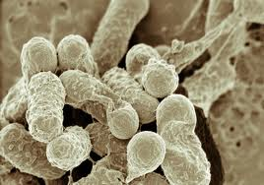
Bacterial Transformation
IV: addition of plasmid or no plasmid
DV: growth or no growth
Joe Cool
Block 1
11/06/14
Mr. Rooks
Title:
Analyzing the Effect of Plasmid on Bacterial Growth

Slide 2
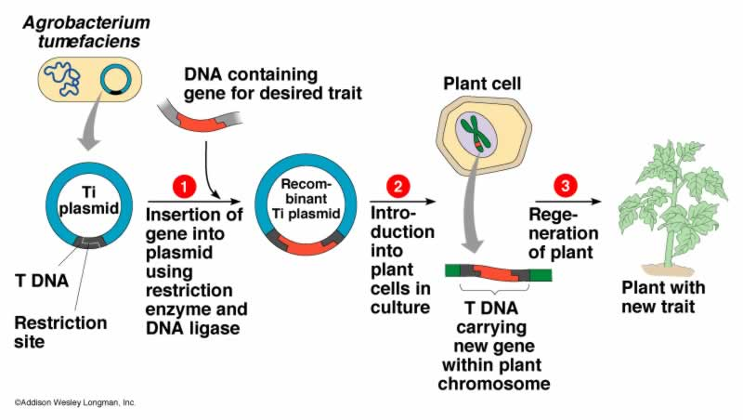

Slide 3
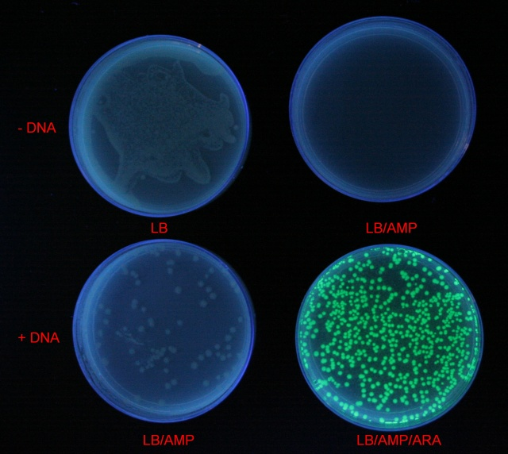
Background
Paragraph form
Answer all the questions
Make sure it flows and makes sense
Proof read

Slide 4
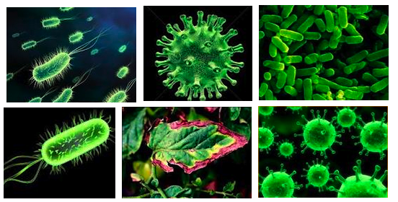
Introduction
Purpose statement using the following words: transformation, ampicillin resistance, and plasmid.
In your own words give a description of the procedure we followed in the lab.

Slide 5
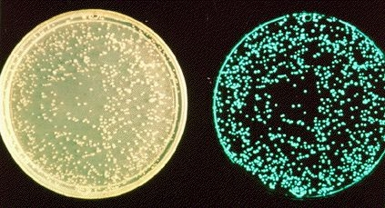
Hypothesis
3 hypothesis
For each of the plates, predict if there will be growth or no growth.
Explain why for each plate.

Slide 6
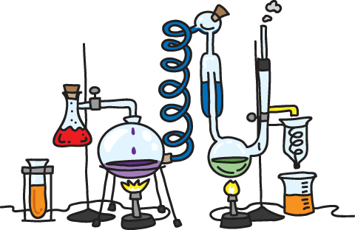
Illustration
Draw each part of the lab procedure. Evenly section off all the parts.
Label every material.
Use a straight edge.
Write captions for each part describing what is going on.

Slide 7
Table
Growth No Growth
(lawn or
colonies )
LB-
LB/Amp-
LB/Amp+

Slide 8
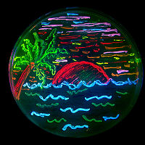
Analysis and Results
Go through each hypothesis and accept or reject. Give reason for each one.
For the 2 control set ups, explain the purpose of each one.
Discuss “real life” applications for the process of biological transformation(research on the Internet).

Slide 9
Sources of Error
If results did not come out as predicted, discuss possible sources of human error by your group and the creators of the lab.
If hypothesis were proven correct, explain what parts of the lab needed special attention to prevent error.

