Slide 1
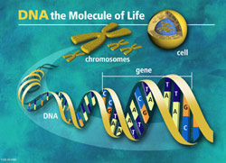
Transcription, Translation, and RNA

Slide 2
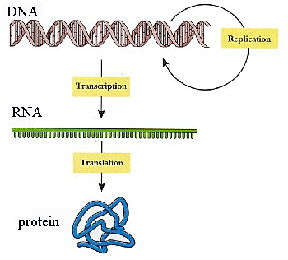
Prefixes, Suffixes and Vocabulary
Transcribe: to copy.
Translate: to change languages.

Slide 3
Lets talk about what we know….
1. We know DNA has all of the information and instructions for the cell.
2. We also know DNA is kept in the nucleus.
3. We know proteins do all or most of the work in the cell.
4. Most of the protein work is done in the cytoplasm.
So now the question that you should be asking yourself is . . .
How does DNA get its information to the proteins?

Slide 4
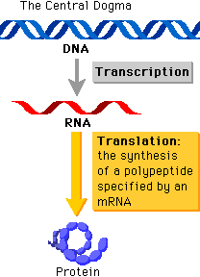
Transcription and Translation.. From Gene to Protein
Overview:
DNA transcribes its information to RNA.
RNA goes through the nuclear pores to the ribosome.
The information is translated into proteins.

Slide 5
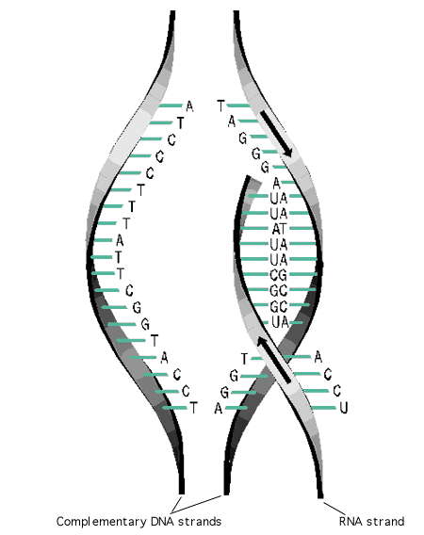
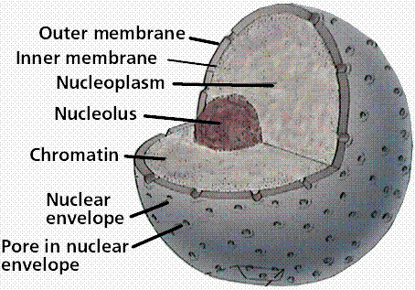
Transcription
DNA is copied to RNA
Both are in the same “nucleotide” language.

Slide 6
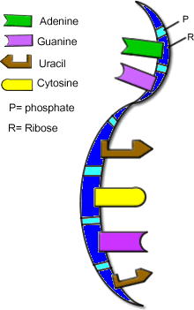
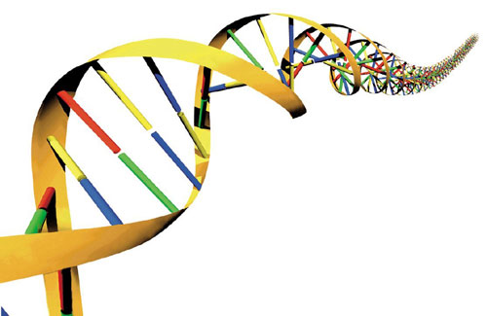
DNA and RNA
Double stranded
A, T, G, C
Found in nucleus
Uses deoxyribose as its sugar
Single Stranded
A, U, G, C
Made in nucleus but transported to the cytoplasm
Uses ribose as its sugar

Slide 7
Uracil is used instead of Thymine!
DNA Strand 5’ ATGCCTAAG 3’
Complementary 3’UACGGAUUC 5’
RNA Strand
Try One:
DNA strand __ T T G A G A C 3’
RNA strand 3’ __ __ C__ C ___ __5’

Slide 8
3 Types of RNA
mRNA - messenger RNA
mRNA carries the information from DNA to the ribosome
tRNA - transfer RNA
tRNA brings the amino acids from the cytoplasm to the mRNA during translation
rRNA - ribosomal RNA
rRNA is the major component that makes up a ribosome

Slide 9
Translation
The order of nucleotides on the RNA determine the order of amino acids in a protein.
The sequence of bases which codes for proteins, has a (4) letter “alphabet” (AUGC).
Codon: 3 nucleotide sequence that codes for an amino acid.

Slide 10
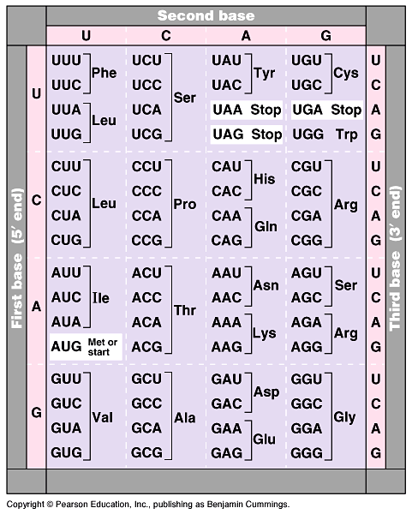
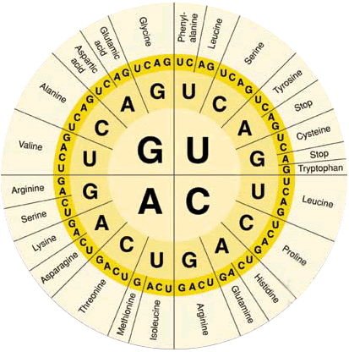

Slide 11
What is the polypeptide chain for the following mRNA sequence?
ACAGUAUGUCUGCGGGGACUUAAC
Find the “start” amino acid sequence first!

Slide 12
Answer!
Met - Ser -Ala -Gly -Thr - (stop)
ACAGUAUG(start)UCUGCGGGGACUUAA(stop)
Try this one..
GUUCAGAUGUCCGCUGAUGGGUGA

Slide 13
Answer!
GUUCAGAUGUCCGCUGAUGGGUGA
GUUCAG Start Ser Ala Asp Gly Stop

Slide 14
Translation
Changing languages from nucleotides (DNA & RNA) to amino acids (proteins).
mRNA is read at the ribosome.
Amino acids are assembled together based on the codon sequence.

Slide 15
