Slide 1
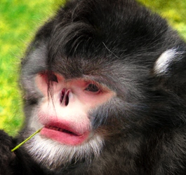
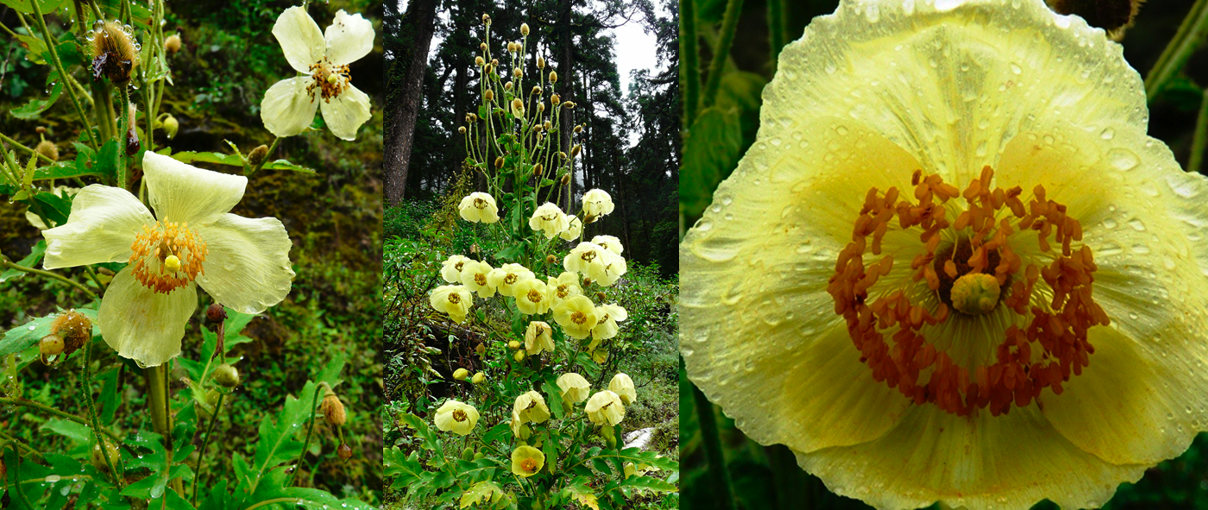
Speciation and Extinction

Slide 2
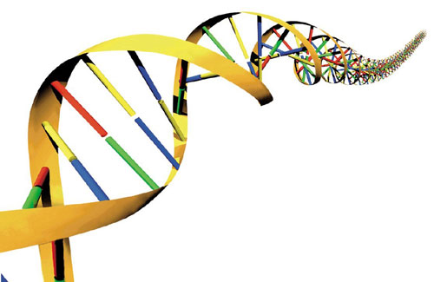
Prefixes, Suffixes, and Vocabulary
Genetic Isolation: the absence of genetic exchange between populations or species.
Gene Pool: all the alleles within a population.
Temporal: having to do with time.
Gene Flow: the transfer of alleles or genes from one population to another.

Slide 3
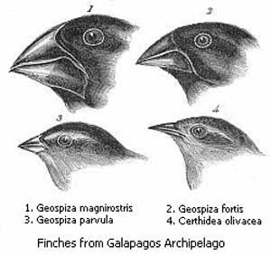
Speciation
When genetic isolation is achieved, GENE FLOW is stopped or prevented.
In this case a separate species is recognized.

Slide 4
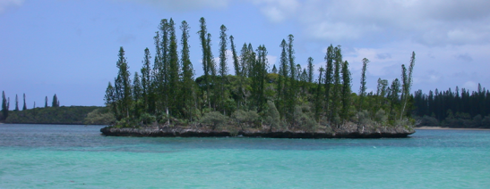
Genetic Isolation
3 main categories…
Geographic Isolation
Pre-Mating Isolation
Post-Mating Isolation

Slide 5
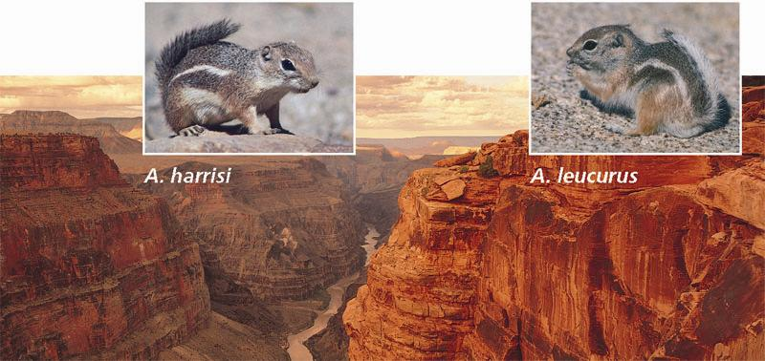
Geographic Isolation
Organisms are separated by a physical barrier therefore they never meet in nature.
Example: river, mountain ocean, highway, etc. separates them.

Slide 6
Pre-Mating Mechanisms
Prevents populations from interbreeding before physical contact occurs.
Mating Rituals: dances, house building.
Songs or Signals: very specific
Pheromones: chemical signals
Temporal Differences: seasons, time of day.

Slide 7
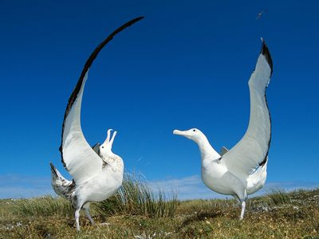
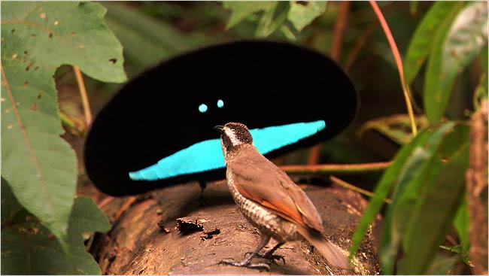
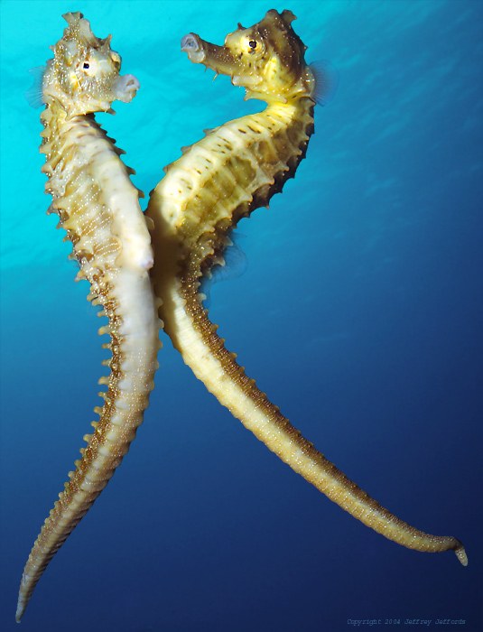
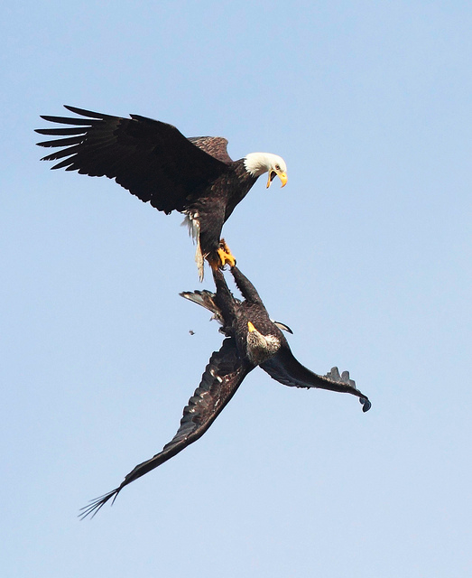

Slide 8
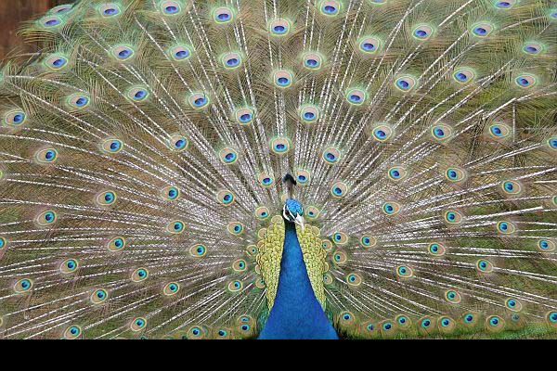
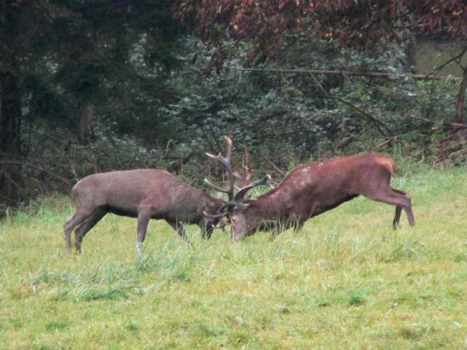
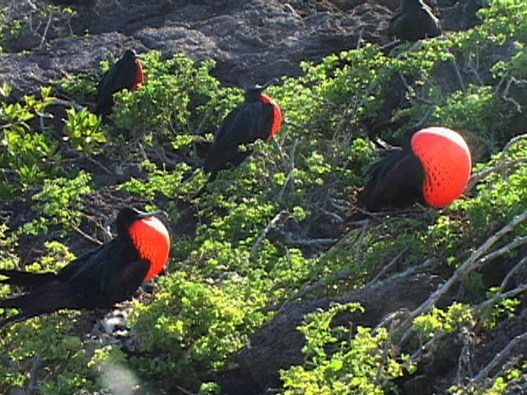

Slide 9
Post-Mating Mechanisms
Prevents gene flow on the rare occasion that the act of mating does take place between 2 species.
Gentalia Shape.
Sperm does not survive in the foreign environment of the female.
Sperm incapable of fertilizing the egg.
If the young survives, it is weak and cannot survive to adulthood.
If the young survives to become an adult it is sterile.

Slide 10
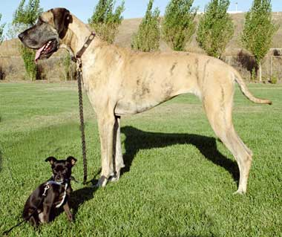

Slide 11
Speciation
Natural selection pushes species towards a better solution.
It makes organisms more specialized.
Only improves an organism.
Limits depend on the variability of an organism.

Slide 12
If the Environment Changes
The animal actually has choices:
#1: The organism can migrate and no evolution takes place.
#2: The organism adapts (those with better genes are able to reproduce).
#3: The organism goes extinct.

Slide 13
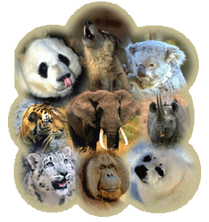
A species cannot or will not evolve when it has no variation.
Very specialized organisms have very little variation.
If a population does not produce phenotypes favorable to the environment…. It becomes extinct : (

