Slide 1
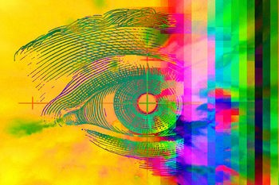
Modes of Inheritance

Slide 2
Prefixes, Suffixes, and Vocabulary
Karyotype: picture of chromosomes.
Genotype: genes present.
Phenotype: physical characteristics.
Sex Linked: on the sex chromosomes.
Autosomal: all chromosomes except the sex chromosomes.

Slide 3
Let Us Review……
Gametes are made during meiosis.
Crossing over during Prophase I increases genetic diversity.
A zygote is created when 2 sex cells fuse.
Alleles separate or segregate from each other during gamete production (Law of Segregation).
Genes separate independently from each other, they are not linked together (Law of Independent Assortment).

Slide 4
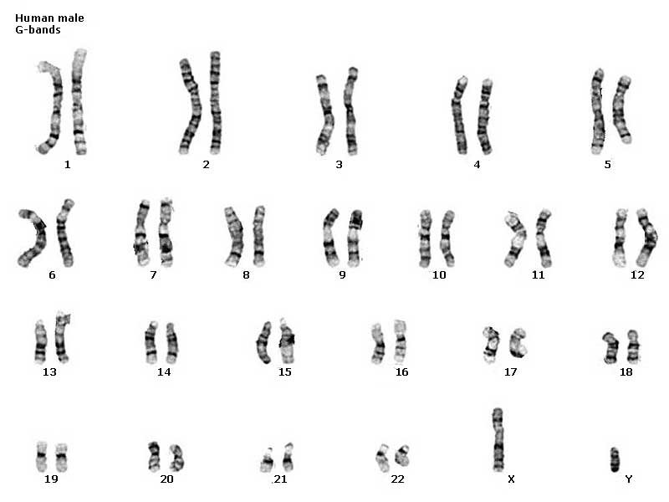
Humans!!!
23 different types of chromosomes(n=23).
Each cell is diploid(2n) having 2 copies of each chromosome.
Each chromosome has its own shape and size.
Karyotypes show pictures of chromosomes.

Slide 5
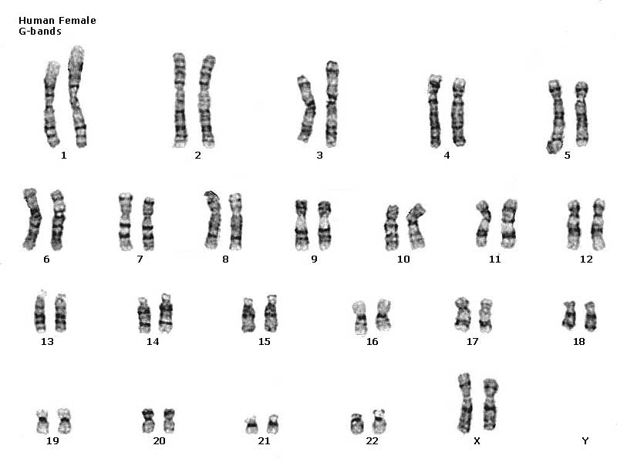
Chromosomes 1-22 are autosomal (non-sex linked).
The 23rd pair are the sex chromosomes.
Determines the sex of a child.
Males have XY.
Females have XX.

Slide 6
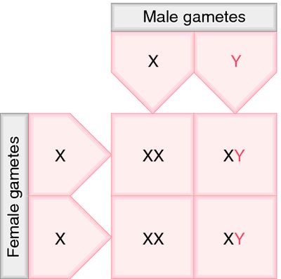
Sex Determination
Males determine the sex of the baby by donating an X or a Y. Females only donate an X.
50% chance male, 50% female every time!!

Slide 7
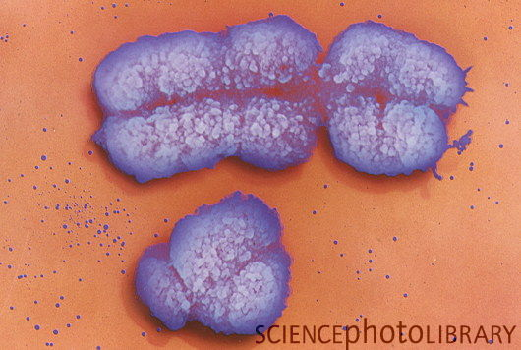
The X Chromosome
Not all genes passed on are on the autosomal chromosomes.
The X chromosome carries many more genes because it is much larger.
Disorders that are “sex linked” are typically found on the X chromosome.

Slide 8
Color blindness is a sex linked characteristic.
Normal vision = dominant allele (C). Colorblindness = recessive allele (c).
Normal X chromosome = X^{C}, colorblind = X^{c}.
A female who sees color has the geneotype X^{C}X^{C} or X^{C}X^{c} (carrier).
A colorblind female has the geneotype = X^{c}X^{c} A male who sees color has the genotype X^{C}Y.
A colorblind male has the genotype X^{c}Y (* notice, he only has one copy of the allele).

Slide 9
Lets look at some crosses to see how sex-linked traits offset offpring phenotypes.
X^{C}X^{c} x X^{C}Y
X^{C}X^{C} x X^{c}Y
X^{C}
Y
X^{c}
Y
X^{C}
X^{C}X^{C}
X^{C}Y
X^{C}
X^{C}X^{c}
X^{C}Y
X^{c}
X^{c}X^{C}
X^{c}Y
X^{C}
X^{C}Y
X^{C}X^{c}
All girls are normal.
50% of boys are normal, 50% are colorblind.
All girls are normal but are carriers.
All boys are normal

Slide 10
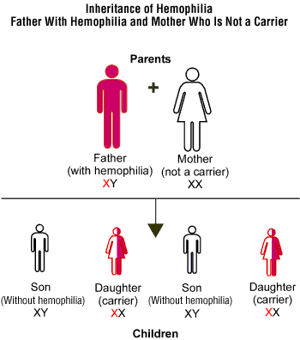

Slide 11
You try a sex linked cross:
Hemophilia is a sex linked recessive trait (Hemophilia is a condition in which blood does not clot normally).
What are the results of the following cross?
Hemophiliac Female Normal Male
X^{h} X^{h}
X^{H} Y

