Slide 1
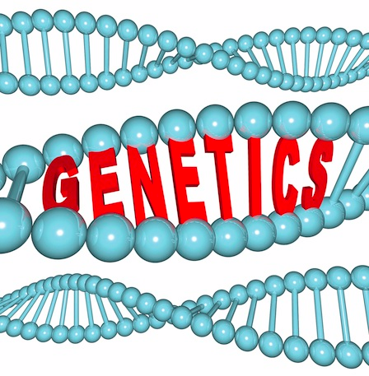
Mendelian Genetics Part 1

Slide 2
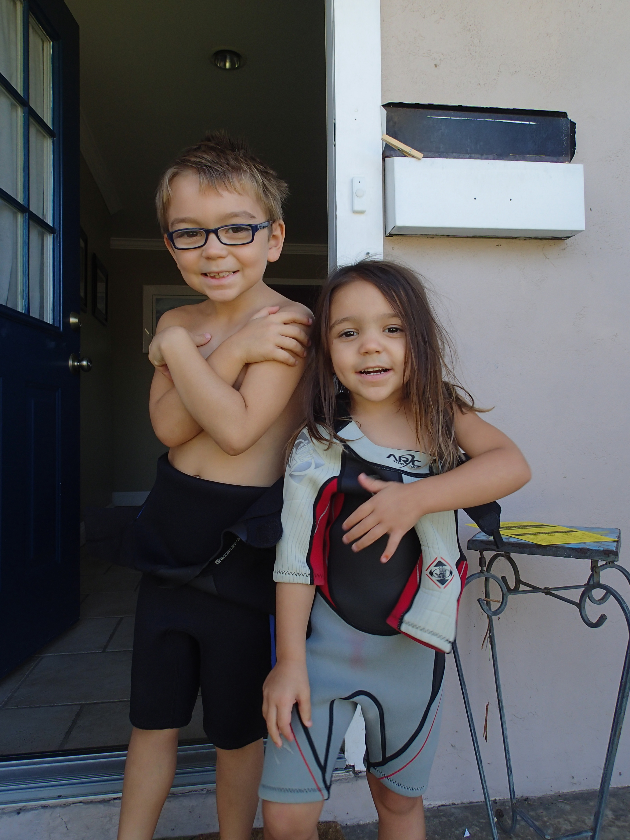
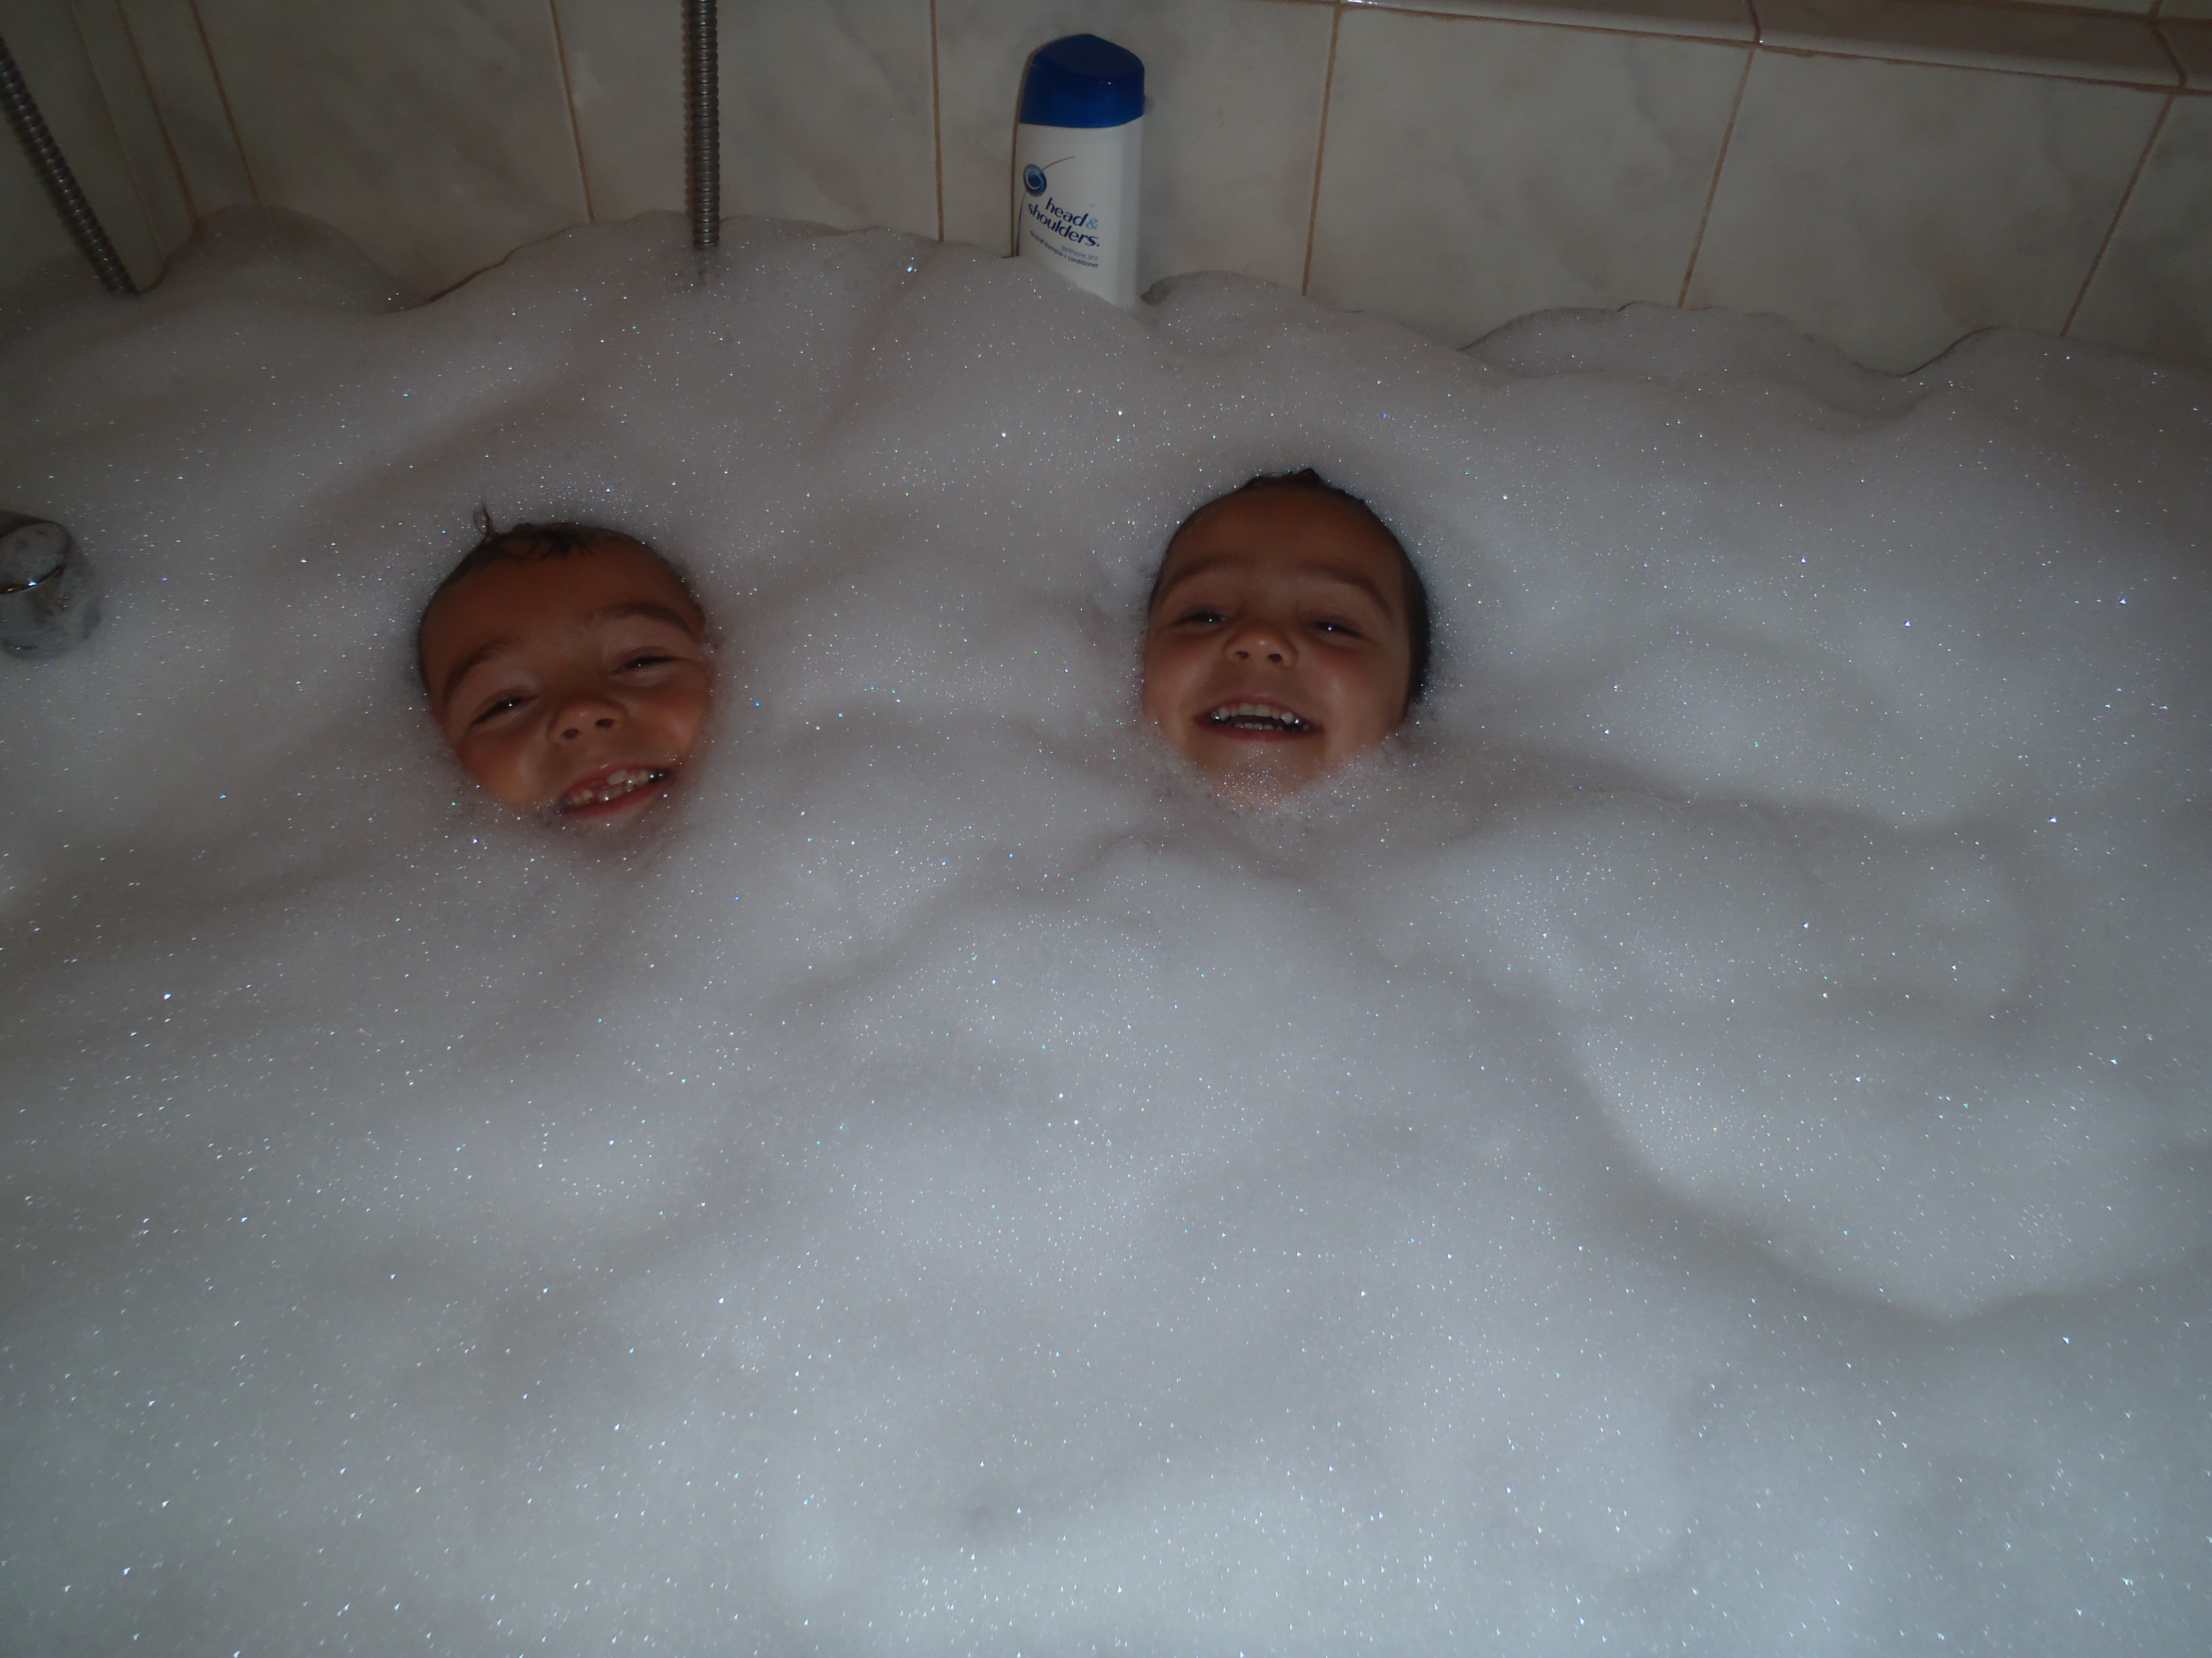
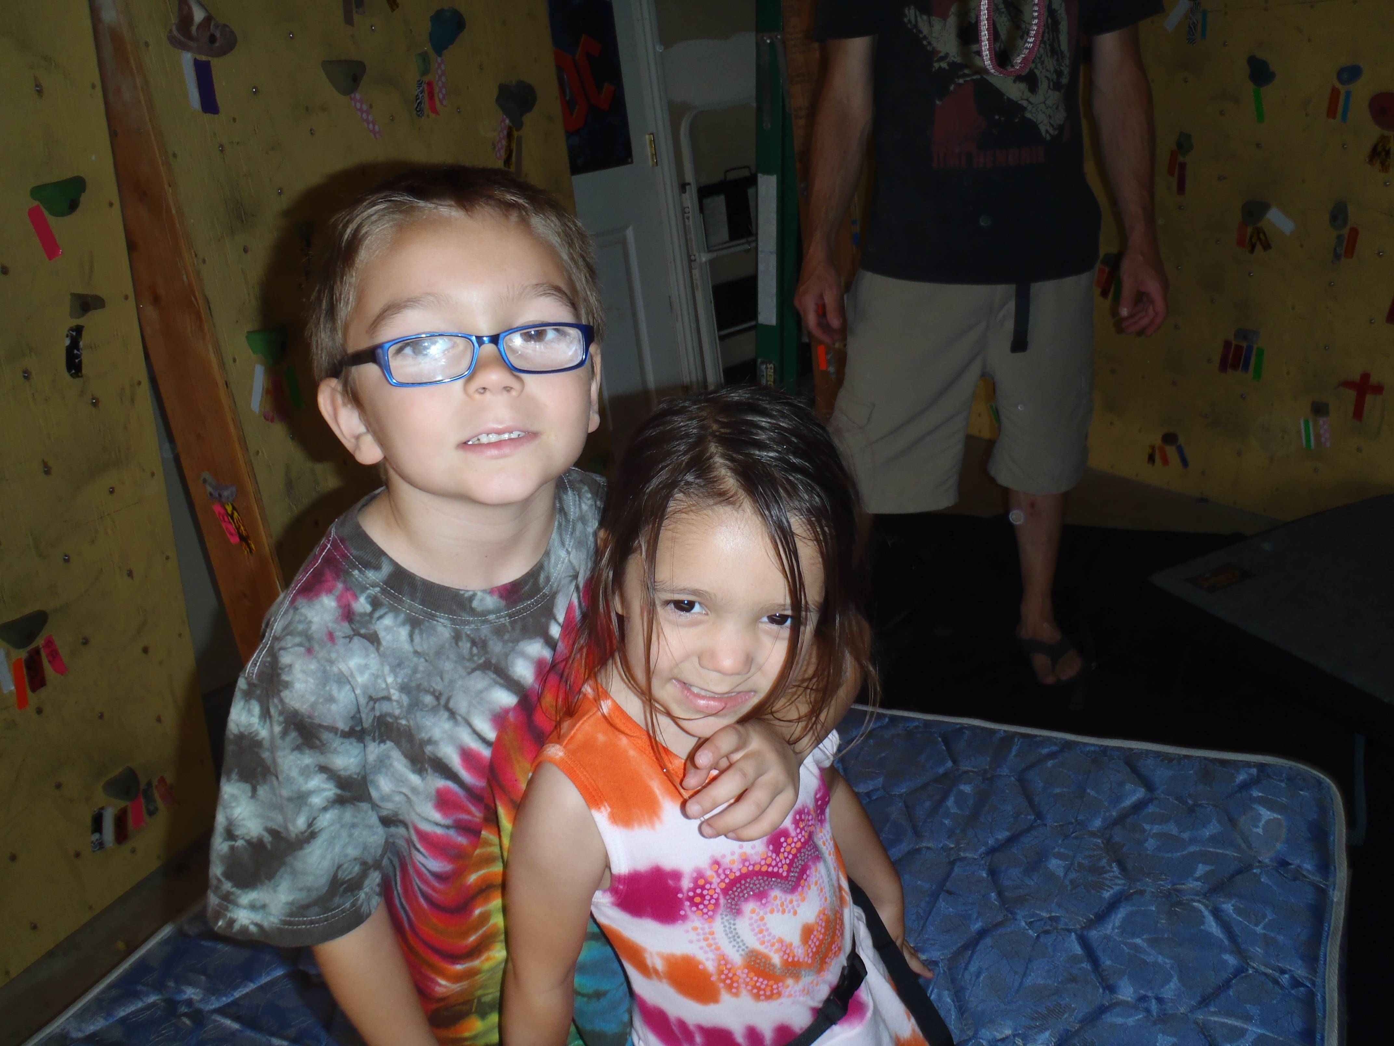

Slide 3
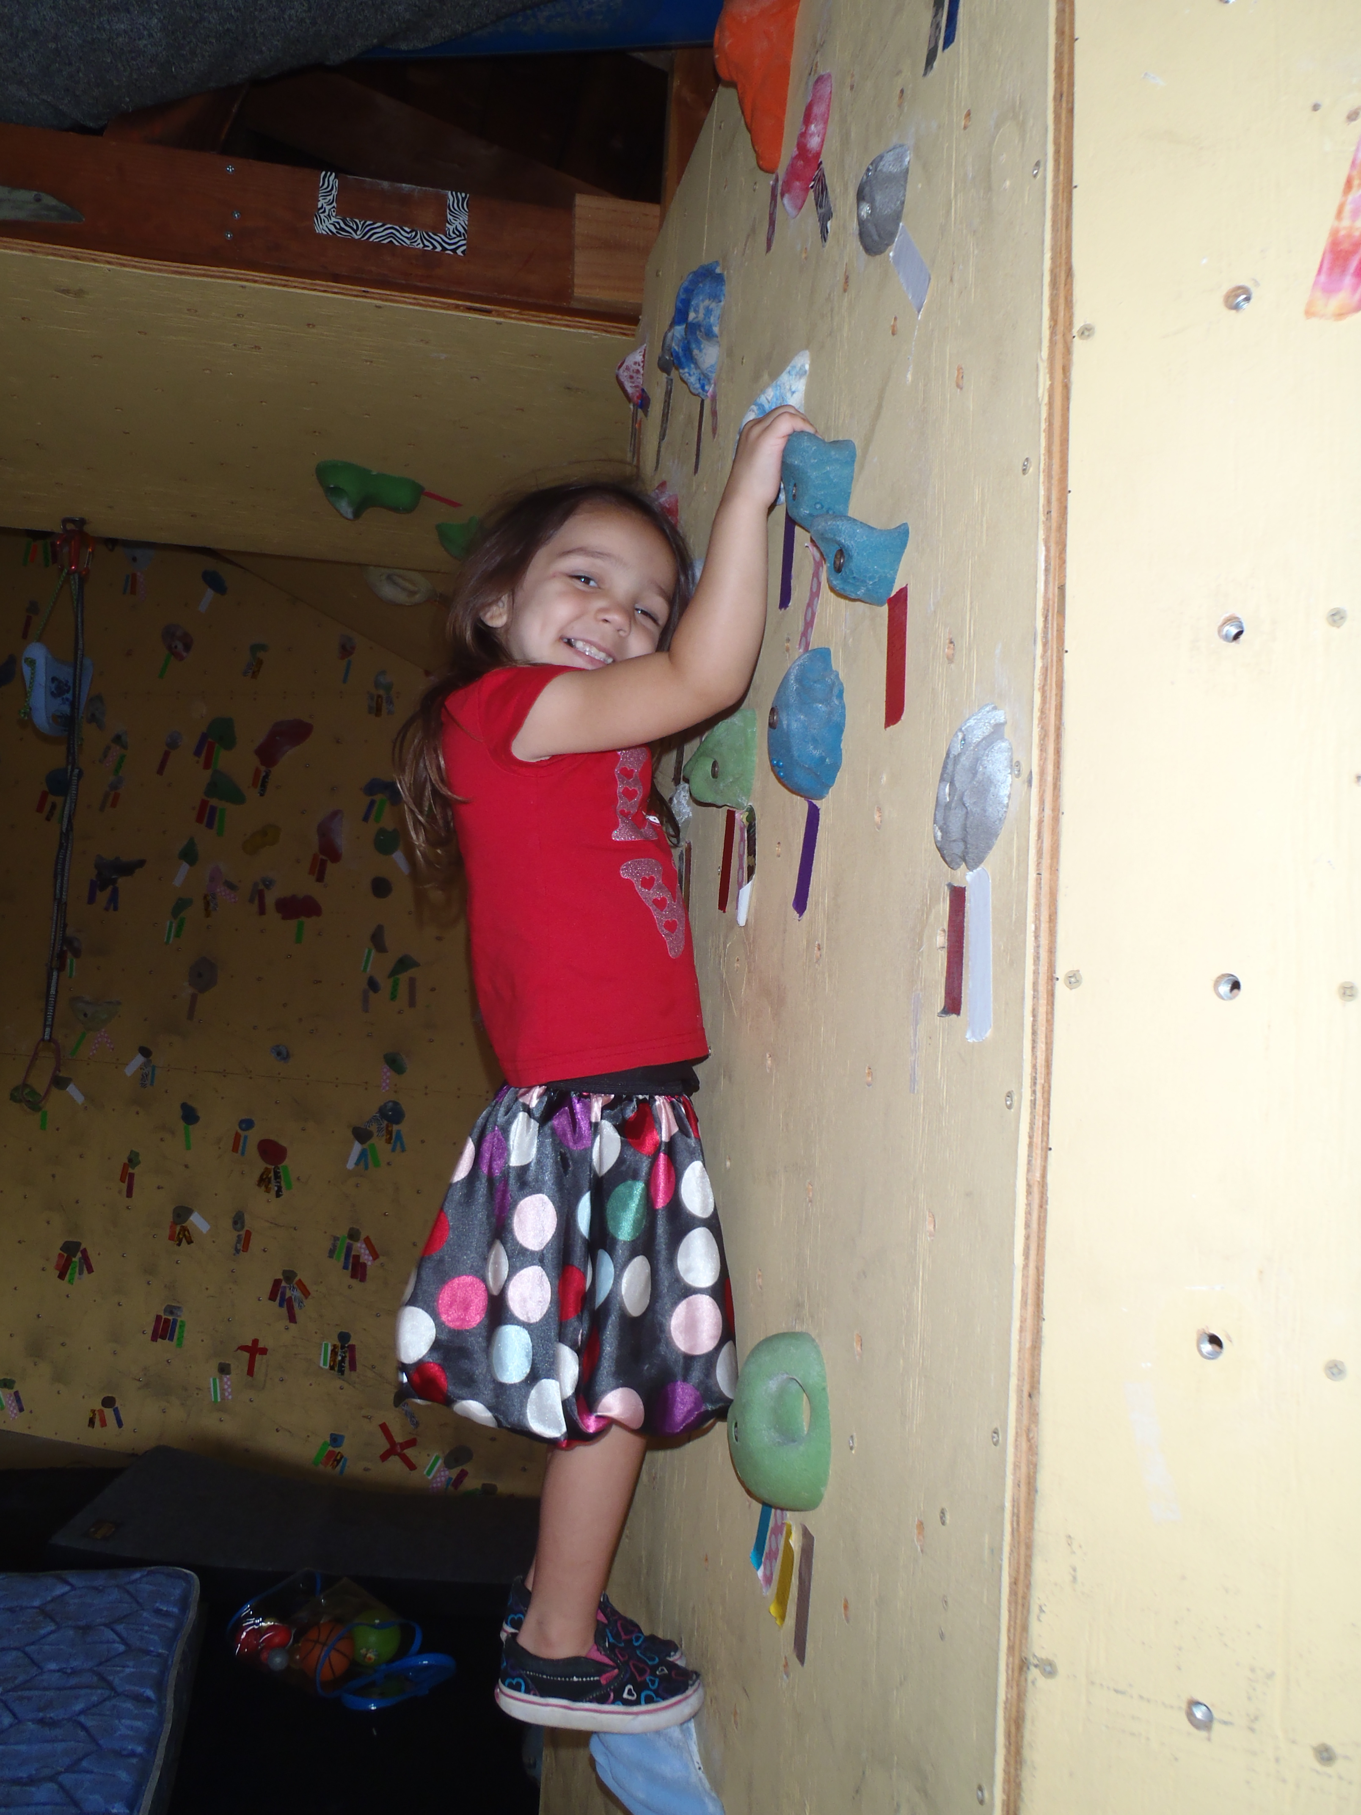

Slide 4
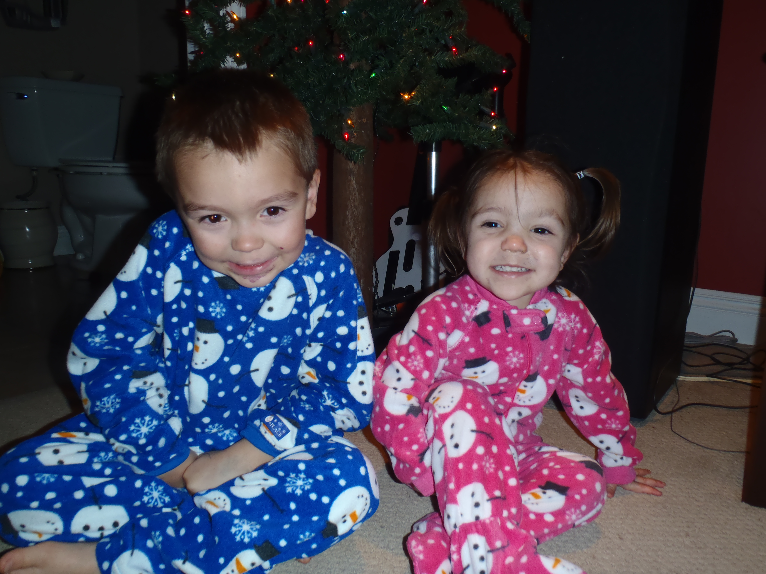
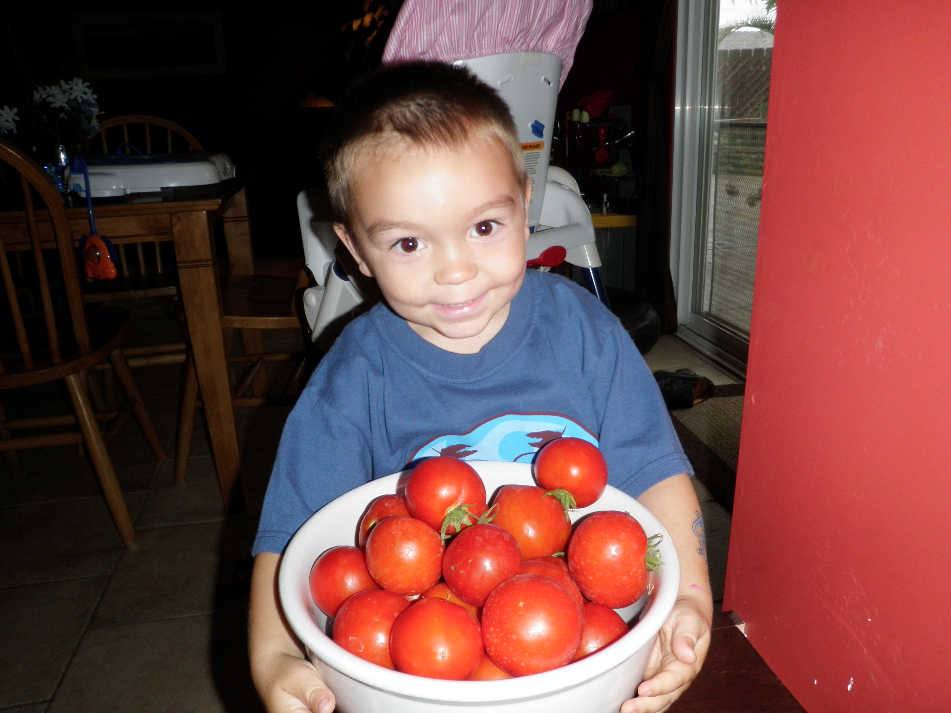
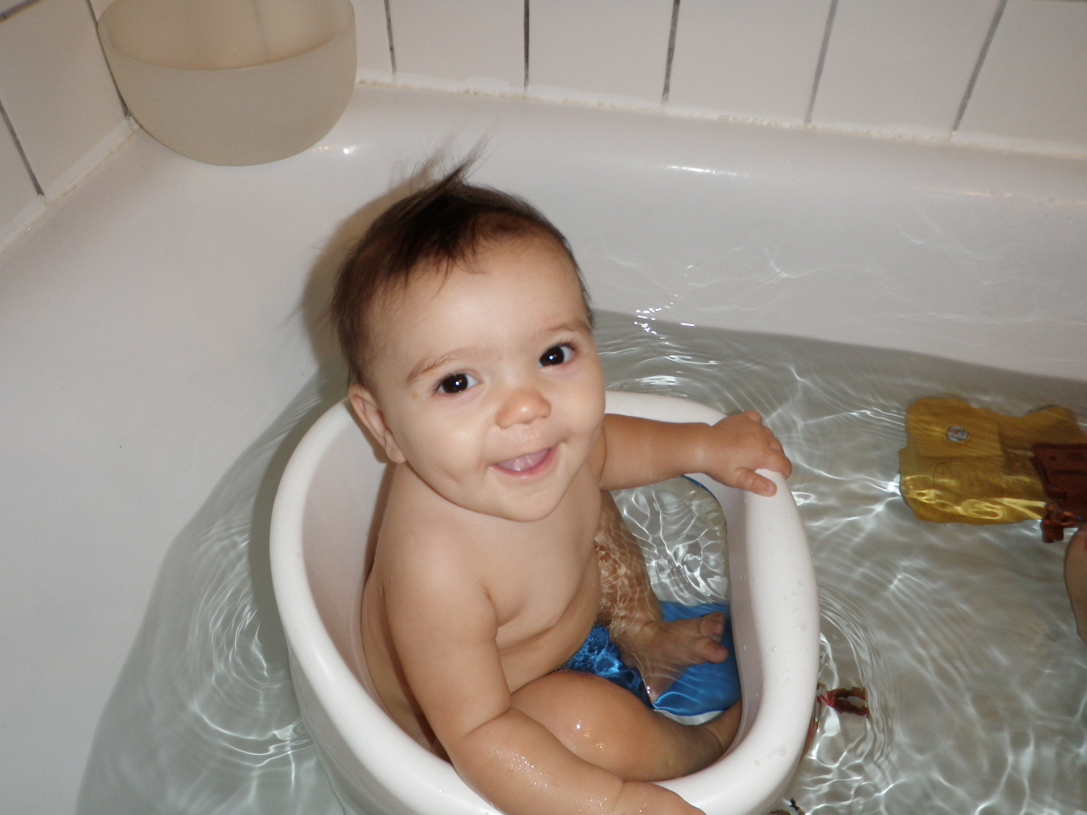

Slide 5
Prefixes, Suffixes, and Vocabulary
Segregate: separate.
Allele: form of a gene.
-Zygous: joining together.
Pheno: physical.
Geno: genes present

Slide 6
What We Already Know….
Gametes(eggs and sperm) are haploid cells produced in the gonads.
Chromosomes we received from our parents are recombined during crossing over in Prophase I.
In meiosis the homologous chromosomes separate first then sister chromsosomes separate.
You might be asking yourself now….What are the consequences of mistake for the chromosome????

Slide 7
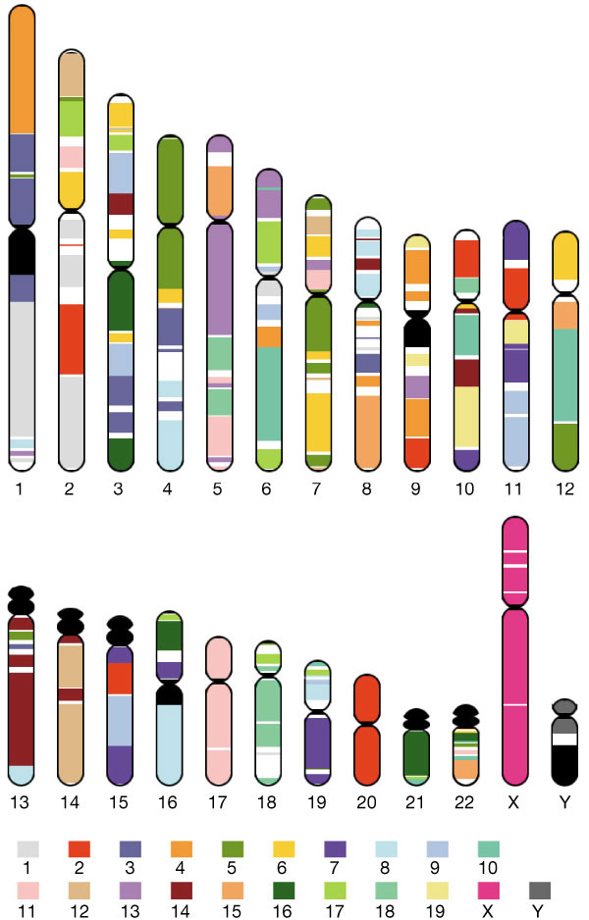
Genes!
Genes are segments of DNA that code for a trait.
Each chromosome has 1000s of genes.
How do genes affect offspring??
Who knows???

Slide 8
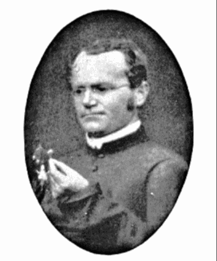
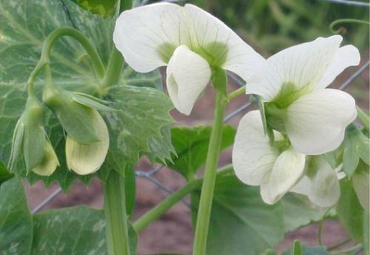
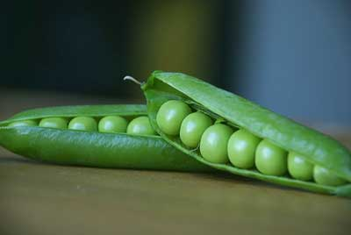
Gregor Mendel
The “Father of Genetics”
Austrian Monk born in 1822.
Used pea plants.
The traits of pea plants (flower color, seed color and shape, and plant height) were easy to identify, measure and count.

Slide 9
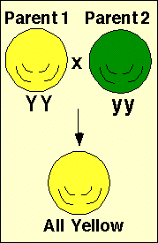
Mendel’s Experiment
Mendel took 2 true breeding pea plants- one with yellow and one with green seeds.
He crossed the yellow and green seed plants.
All the F1had yellow offspring.
True Breeding: both genes the same.
F1: First Filial Generation, the first generation.

Slide 10
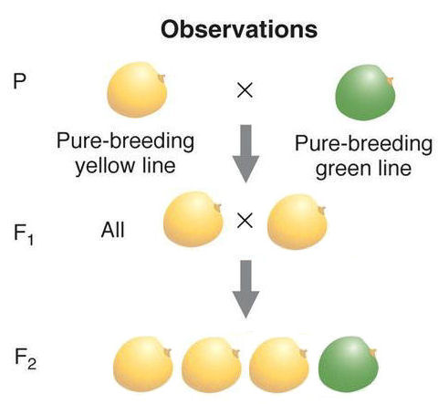
Mendel took two of the offspring from the F1 generation, each with yellow seeds and crossed them (called an F1 cross).
The green seed re-appeared in the F2 generation.

Slide 11
Mendel gave names to the characteristics:
Alleles that disappeared he called recessive. Recessive alleles get a lower case.
Alleles that appeared in the first and dominated the 2nd he called dominant. Dominant allele gets a capital letter.
Each individual has 2 copies of each allele.
Genotype: the genes present.
Phenotype: the physical characteristics.
Homozygous: the two alleles are the same.
Heterozygous: the alleles are different.

Slide 12
If an individual has a dominant allele it displays the dominant allele it dispalys the dominant characteristic.
YY = yellow seeds
Yy = Yy = yellow
An individual needs 2 recessive alleles to display the recessive characterstic.
yy = green seeds.

Slide 13
Punnett Square
Used to predict future allele probabilities.
Mendel used these constant results and his ability to predict these results to form a central idea in genetics.
The Law of Segregation: all alleles have equal chance of being passed to the gamete and eventually the zygote.

