Slide 1
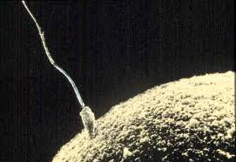
Meiosis

Slide 2
Prefixes, Suffixes, and Vocabulary
Diploid: 2 sets of chromosomes(2n).
Haploid: 1 set of chromosomes(n).
Gamete: sex cell.
Somatic cell: all body cells except sex cells.
Zygote: fertilized egg.
Homologous Chromosomes: chromosomes that code for the same traits (eye color, hair, etc).

Slide 3
What We Already Know….
In mitosis we learned that cells divide because:
- Living things need to grow and develop
- When a cell gets too big effective cell transport and communication become difficult.
Living things need to reproduce themselves.
How do living things reproduce themselves….

Slide 4
Humans and Sex
Each of our cells has 23 pairs of chromosomes(n=23) for a total of 46 in each nuclei.
In sexual reproduction the female egg combines with the sperm to make 1 cell called the zygote.
The egg and sperm are haploid(n) so when they make the zygote it is diploid.
n + n = 2n
Egg + sperm = Zygote

Slide 5
How does the # of Chromosomes Reduce?
Meiosis: the process of cellular division that creates sex cells (eggs and sperm).
Similar to mitosis but where it happens and the final results are very different.

Slide 6
Comparing the Who, What, Where, When, Why & How of Cellular Division
Mitosis
Who: Diploid Cell
What is Final Product: 2 identical daughter cells that are diploid(2n)
Where: Somatic Cells
When: After Cell Growth.
Why: Growth, replace old cells.
Meiosis
Who: Diploid Cell
What is Final Product: gametes that are haploid(n)
Where: Gonads (ovaries and testes)
When: Depends.
Why: Reproductive cells.

Slide 7
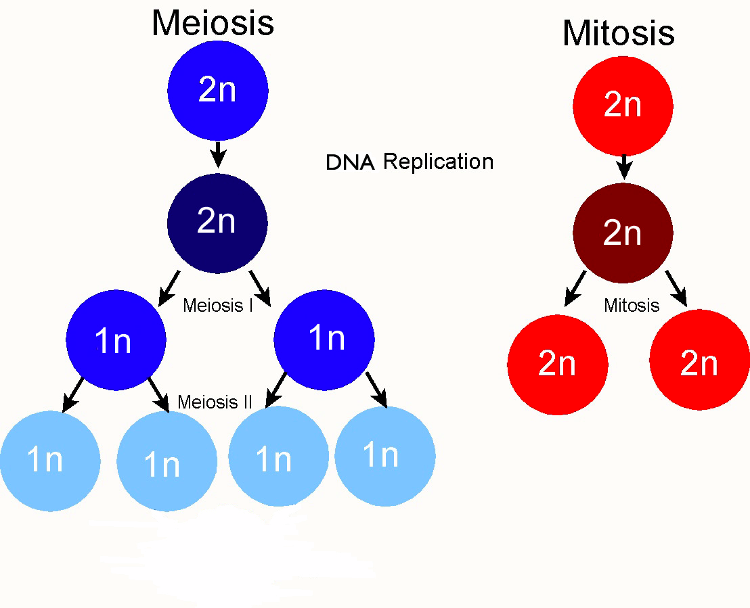

Slide 8
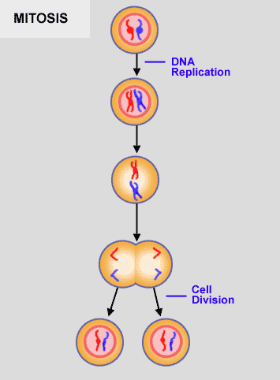
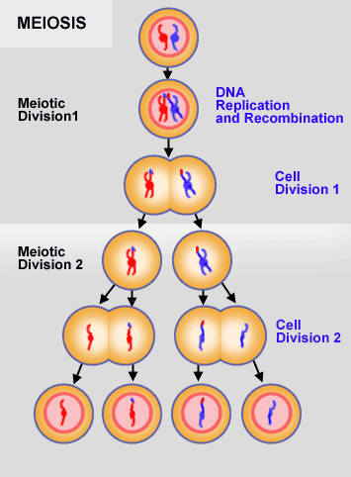

Slide 9
Meiosis- Prophase 1
Chromosomes become visible.
Nuclear membrane breaks apart.
4 copies of each type of chromosome come together called a tetrad. Crossing over occurs.
Crossing over: exchange of section of chromosome.
Crossing over increases genetic diversity!

Slide 10
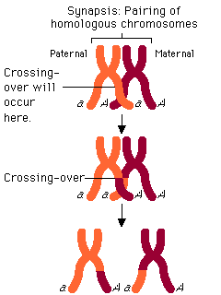
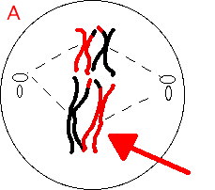

Slide 11
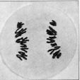
Metaphase I
Chromosomes align in the center of the cell.
Spindle fibers attach to chromosomes.
Identical copies are called sister chromatids.
Pairs of chromosomes are called homologous (they code for the same traits).
Anaphase I
Spindle shortens.
Homologous chromosomes separate.
Sister chromatids stay together.

Slide 12
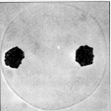
Telophase I
Homologous chromosomes have moved through the opposite ends of the cell.
No cytokinesis yet.
Sister chromatids must separate next…

Slide 13
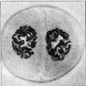
Prophase II
Spindle fibers begin to form centrioles again.
Chromosomes are coiled.
One set of homologous chromosomes and their duplicate (sister chromatid) are separated already.

Slide 14
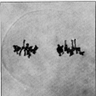
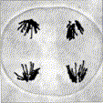
Metaphase II
Sister chromatids align at the center of the cell.
Spindle fibers attach to each chromosome.
Anaphase II
Sister chromatids separate.
Each chromosome is pulled to the opposite end of the cell.

Slide 15
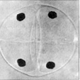
Telophase II
Spindle fibers disappear.
Nuclear membrane form around each new set of chromosomes (4).
Final result is 4 haploid gametes.

Slide 16
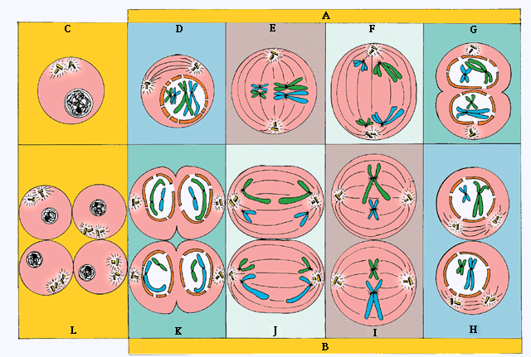

Slide 17
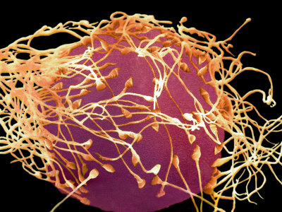
After successfully completing meiosis an individual can reproduce.
During reproduction, 2 gametes (sperm and eggs) come together and fuse nuclei.
The fertilized egg is called a zygote.

