Slide 1
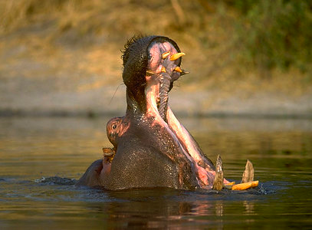
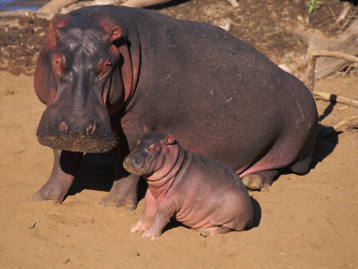
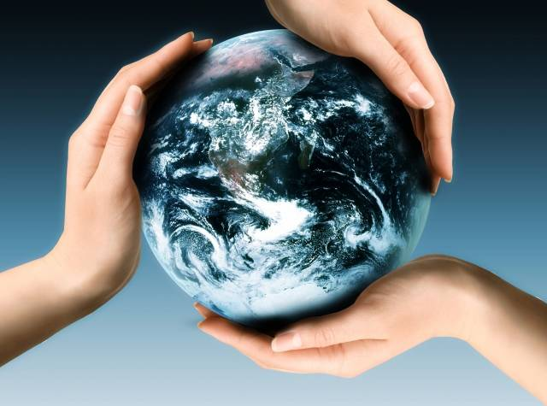
Ecological Problems and Human’s Role
H.I.P.P.O

Slide 2
Prefixes, Suffixes, and Vocabulary
Harvest: to collect, gather, or take.
Accumulation: a build up.
Acronym: Initials that stand for something.
Extinction: total annihilation of genes.

Slide 3
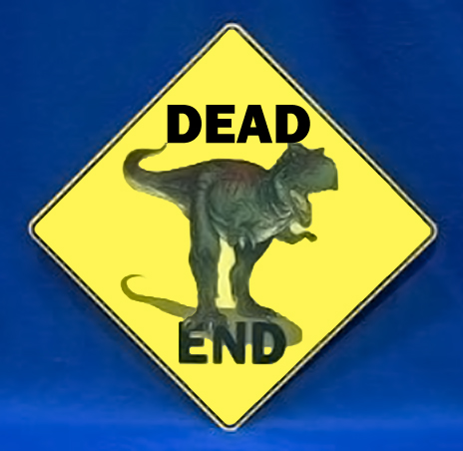
Extinction
Five “mass extinctions” have occurred since life began on Earth.
Estimated than 90% of all organisms that have ever lived on Earth are extinct.
Estimated that up to ½ of presently existing species may become extinct by 2100.

Slide 4
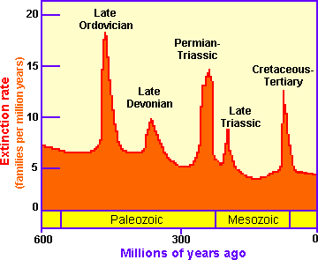

Slide 5
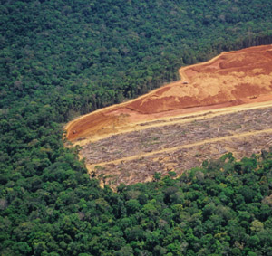
Habitat Destruction
When the natural habitat is rendered functionally unable to support the species present.
Species are displaced or destroyed ultimately reducing biodiversity.
Ranked as the primary cause of species extinction world wide.
Contributes to global warming.

Slide 6
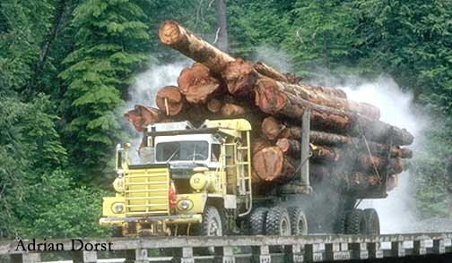
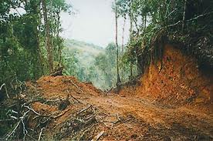
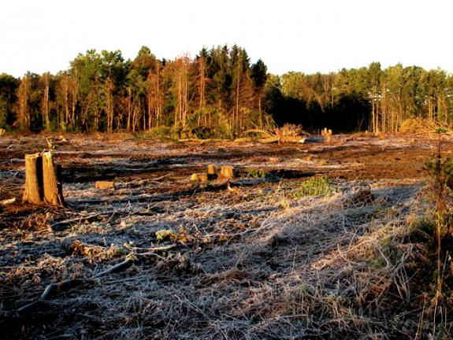
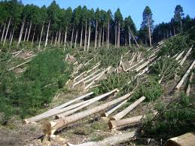

Slide 7
Invasive Species
(Also called exotic, non-native, or introduced)
Species brought into an area(accidentally or on purpose) in which they normally do not live.
Typically do not have natural predators therefore population numbers grow fast.
Take over nitches.
Examples: zebra mussel, pythons, Asian carp, killer bees, ice plant and many more….

Slide 8
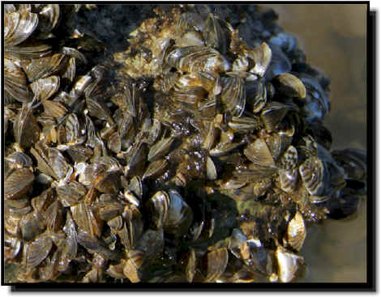
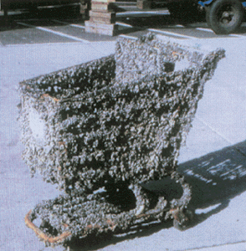
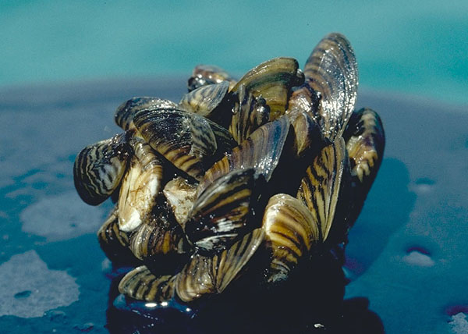

Slide 9
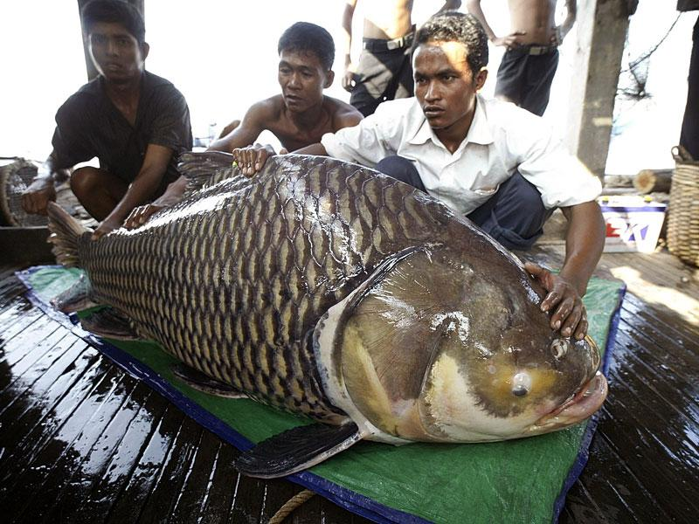
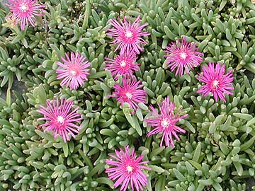
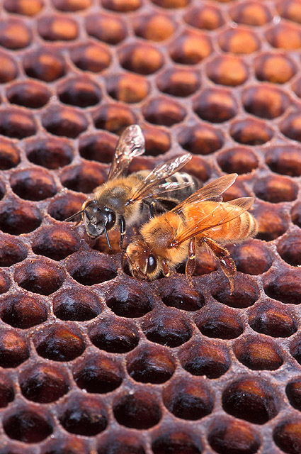
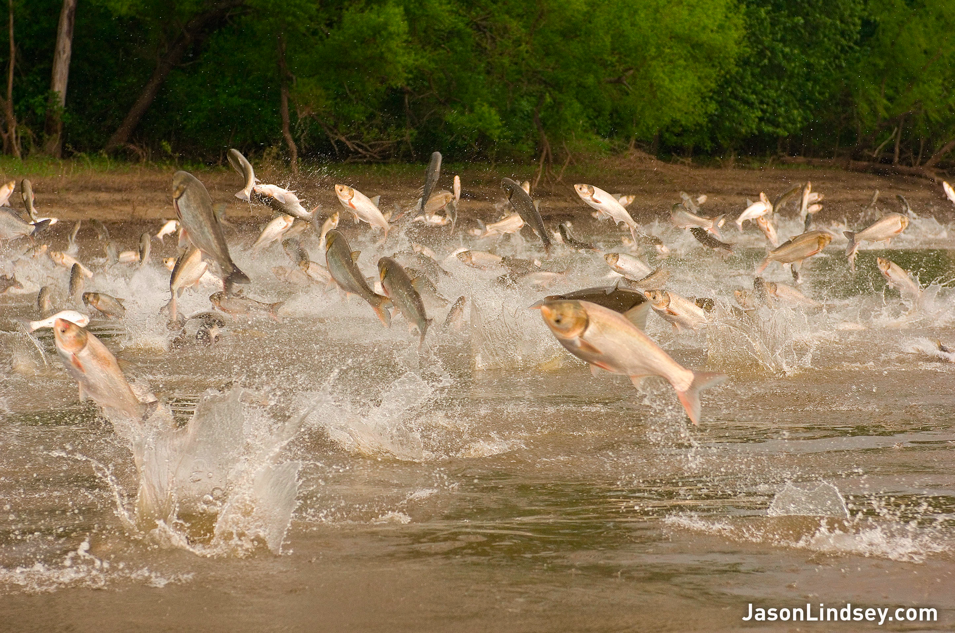

Slide 10
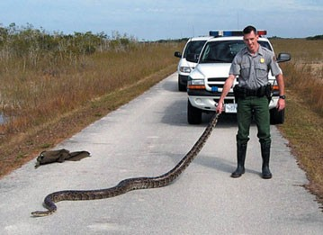
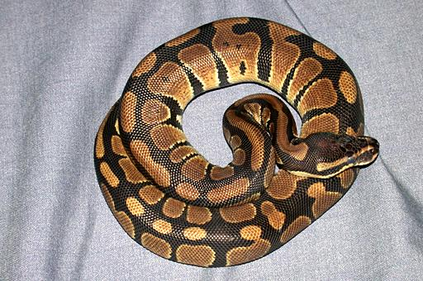
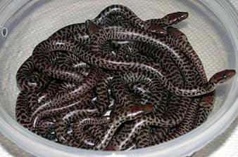
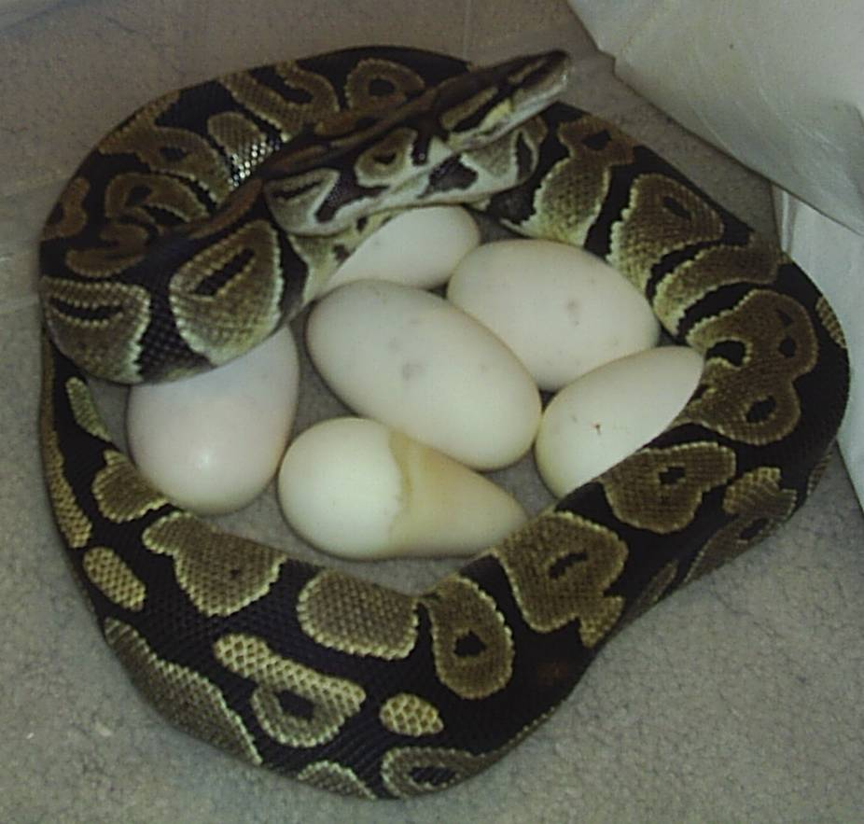

Slide 11
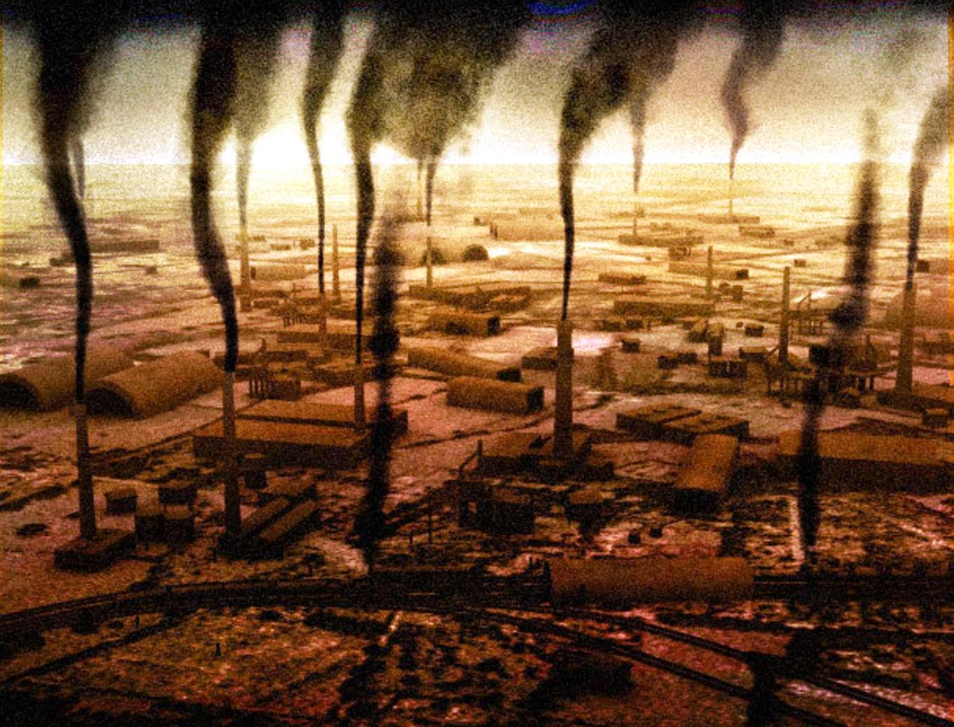
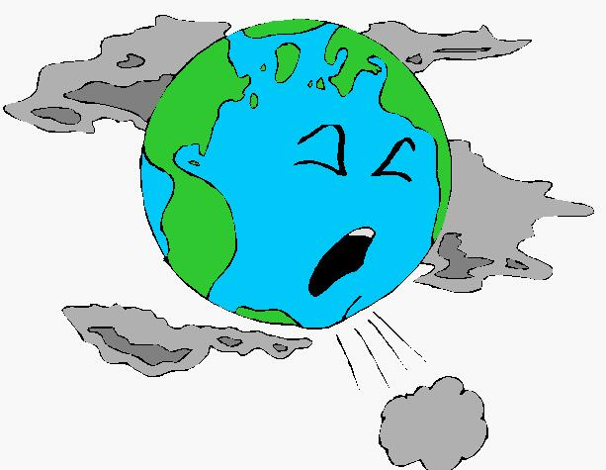
Pollution
The introduction of contaminants into a natural environment that causes instability, disorder, or harm to the ecosystem.
Pollution can take the form of chemical substances or energy such as heat or light.
Bioaccumulation: the increase in concentration of a substance that occurs in a food chain.

Slide 12
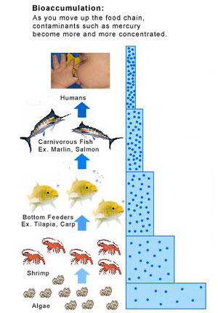

Slide 13
Just the Facts, Just Listen
40% of America’s rivers and 46% of America’s lakes are too polluted for fishing, swimming or aquatic life.
1.2 trillion gallons of untreated gallons of untreated sewage, storm water, and industrial wastes are discharged into US waters annually.
Each year US factories spew 3 million tons of toxic chemicals into the air, land, and water.
The #1 polluter in the world is the US government.

Slide 14
Population
Over 7 BILLION humans inhabit the Earth.
Projected population estimates are 10.6 billion in 2030!
Estimates for the carrying capacity of the Earth are between 4 billion and 16 billion.
Make your own conclusions…..

Slide 15
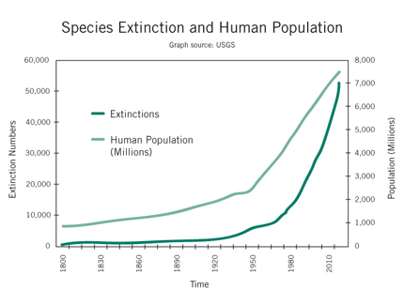

Slide 16
Overharvesting
Harvesting a renewable resource to a point where it cannot return.
Disrupts food chains like dominoes and will eventually effect the entire ecosystem.
Large species that take years to mature & reproduce are especially susceptible.
It is important to follow harvesting quotas and eliminate poaching.

