Slide 1
Genetics Part II

Slide 2
Punnet Squares Continued..
Monohybrid Cross: prediction of offspring for 1 trait.
Dihybrid Cross: prediction of offspring for 2 traits.
S= smooth
Seed shape s = wrinkled
Seed color Y = yellow
y = green

Slide 3
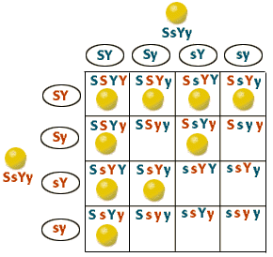

Slide 4
Mendel’s Law of Independent Assortment: All genes/alleles sort independently of each other when they are on different chromosomes.
Mendel got lucky & studied alleles that occurred on different chromosomes.

