Slide 1
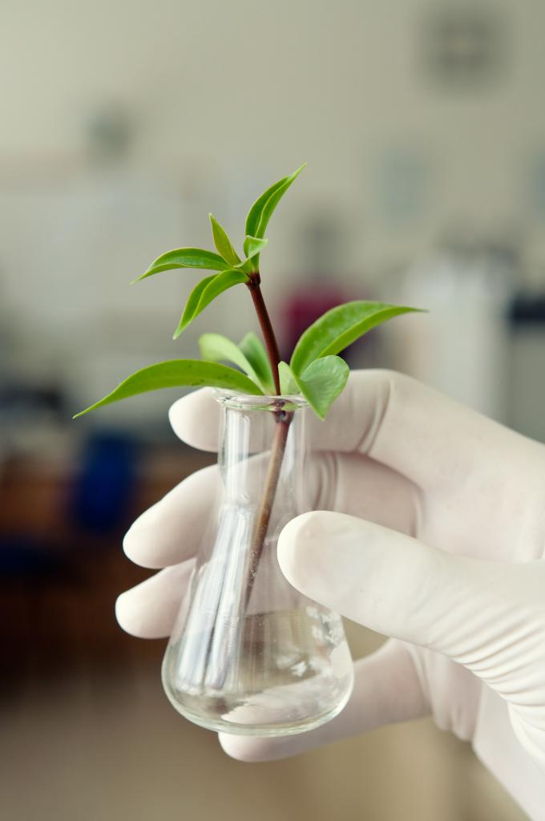
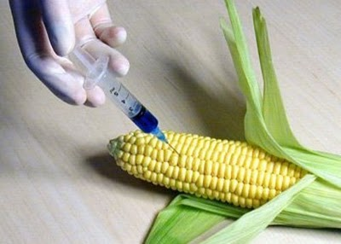
Genetic Engineering
and
Biotechnology

Slide 2
Prefixes, Suffixes, and Vocabulary
Genetic Engineering: directly manipulating DNA for a desired result.
Selective Breeding: choosing what to breed.
Transgenic Organisms: organisms that have DNA from another species.
Recombinant DNA Technology: Combining DNA from 2 or more species.

Slide 3
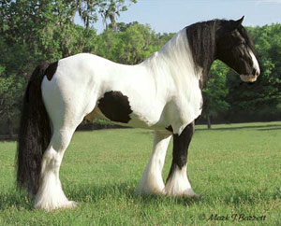
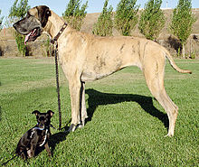
Selective Breeding
Also know as artificial selection.
Organisms are selected and breed for desirable traits.
Examples:
Domestic dogs
Horses
Crops

Slide 4
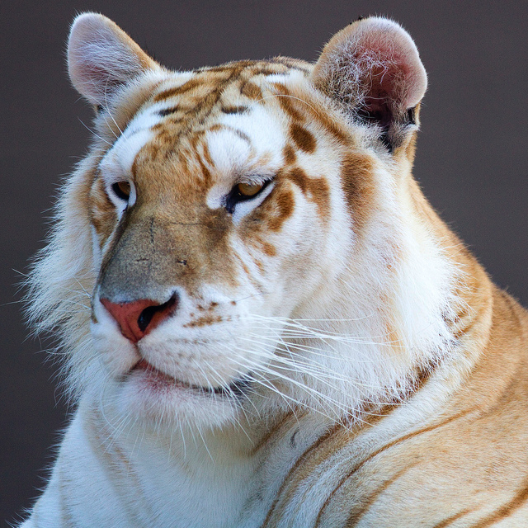
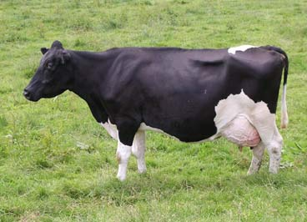
Hybridization
Crossing dissimilar individuals to bring together the best of both organisms.
Tend to be hardier species.

Slide 5
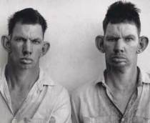
Inbreeding
The continued breeding of individuals with similar characteristics.
Major problem: more likely to cross two recessive alleles producing genetic defects.

Slide 6
Genetic Engineering
Directly manipulating DNA for desired results.
Faster, more reliable method for increasing the frequency of a specific allele.
Examples:
Medical Products
Agriculture

Slide 7
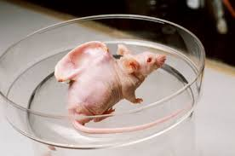
Medical Products
Vaccines
Insulin, Human Growth Hormone
Proteins
“Spare Parts”
Agricultural Products
Reducing the need for pesticides
Improving yields
Drought resistance
Cold tolerance

Slide 8
Concerns??
Allergies
“Superweeds”: natural plants acquiring a resistance to herbicides.
Unknown??

