Slide 1
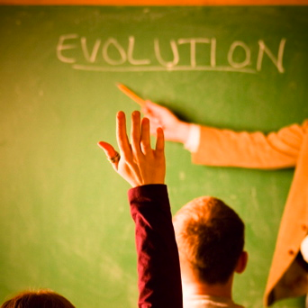
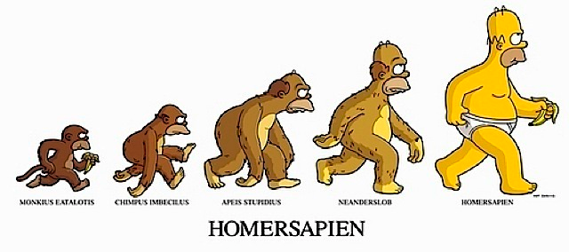

Slide 2
Current Polls (National Geographic 2005)
In the US 14% of adults thought that evolution was “definitely true”
In European countries including Denmark, Sweden, and France, more than 80% of adults surveyed answered yes to the same question
The only country included in the study where adults were more likely than Americans to reject evolution was Turkey
Fewer than half of Americans adults can provide a minimal definition of DNA

Slide 3
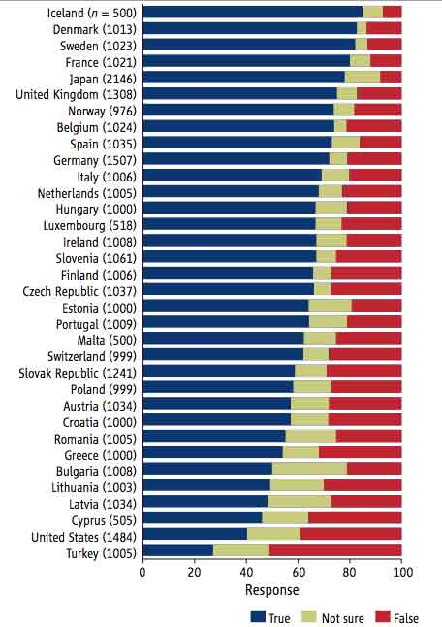

Slide 4
65% of Americans don’t agree that more than 1/2 of genes are common between humans and chimpanzees (National Geographic 2006)
Newsweek Poll 2004
79% of Americans believe that, as the Bible says, Jesus Christ was born of the Virgin Mary, without a father
67% say that they believe the entire story of Christmas- the Virgin Birth, the angelic proclamation to the shepherds, the Star of Bethlehem and the Wise Men- is historically accurate
55% of Americans polled believe that every word of the Bible of literally and historically accurate

Slide 5
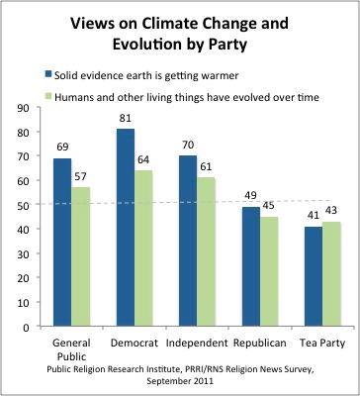

Slide 6
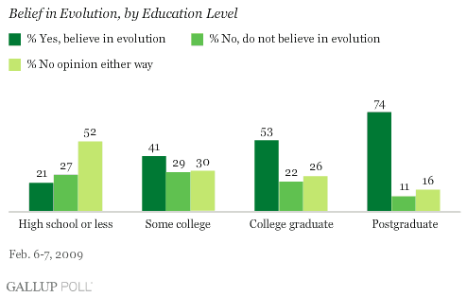

Slide 7
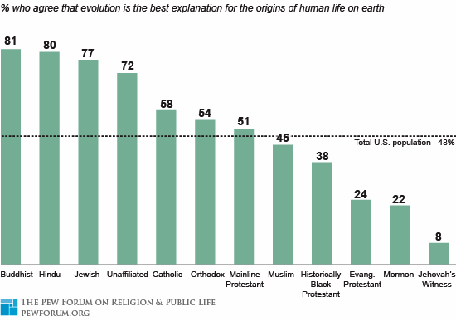
http://4brevard.com/choice/international-test-scores.htm

Slide 8
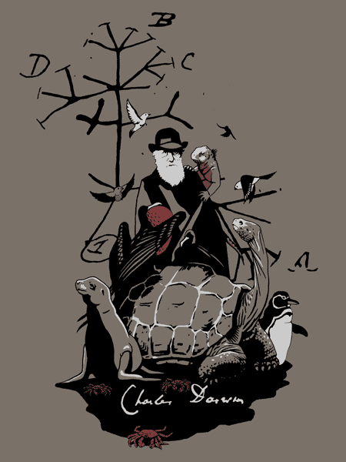
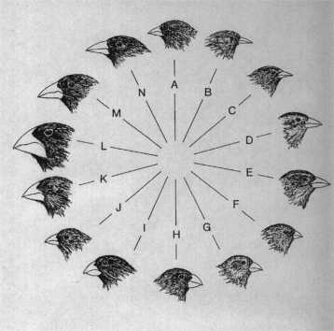
Evolution and Natural Selection

Slide 9
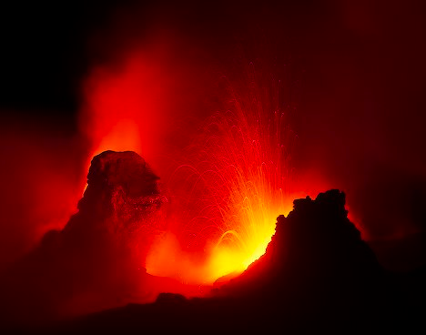
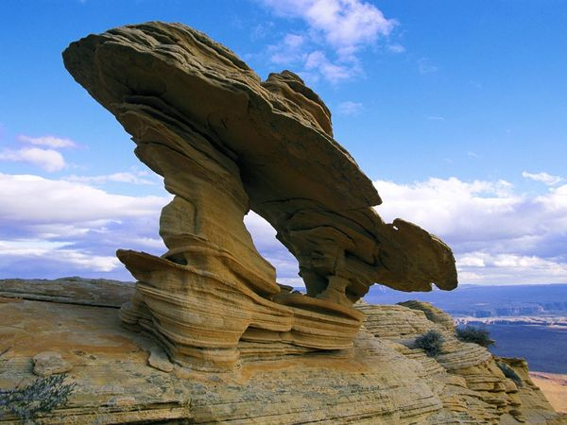
Prefixes, Suffixes, and Vocabulary
Uniformitarianism: the forces that shaped the Earth millions of years ago are still shaping the Earth today.

Slide 10
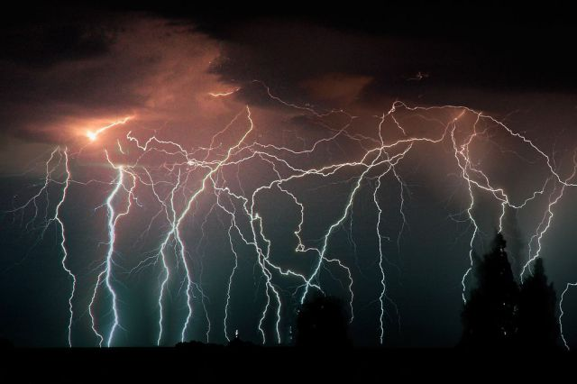
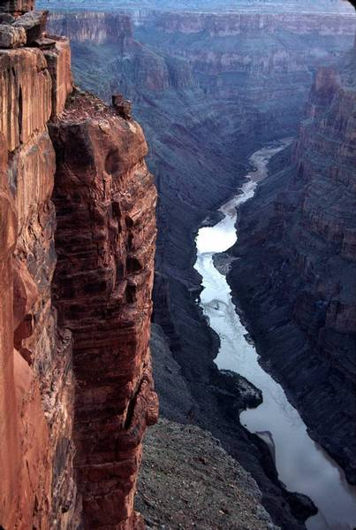
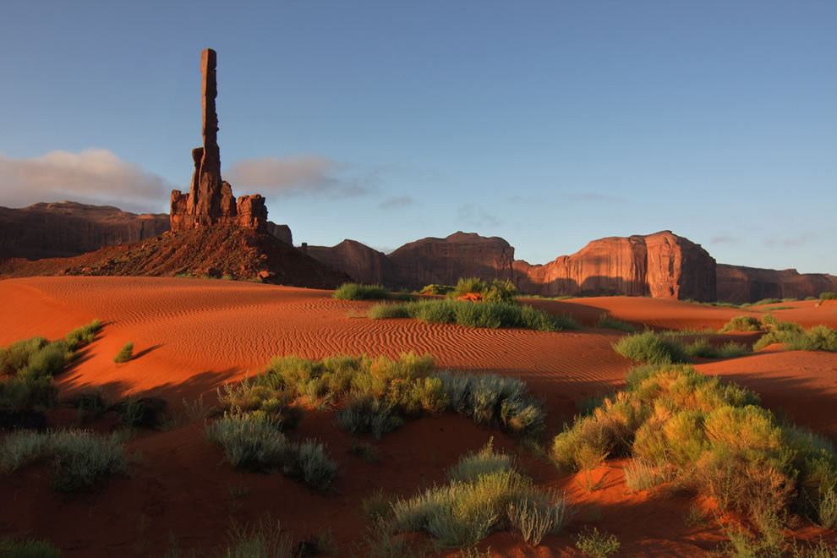

Slide 11
What We Have Learned So Far..
DNA contains all the info for the entire body plan.
DNA can change = mutations.
DNA is passed from parent to offspring.
Genes are shuffled on chromosomes during crossing over.
An individual displays(phenotype) the characteristics of its genetic combination (genotype).
Each individual has a unique genetic combination(identical twins are the exception).
Humans have learned to select (artificial selection) for or choose traits in plants and animals that we want or need.

Slide 12
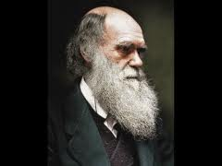
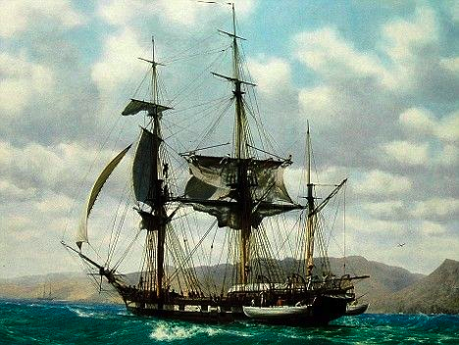
Charles Darwin: The Father of Evolution
At 22 he sailed on the HMS Beagle to the Galapagos Islands in South America.
He worked as a naturalist studying the natural environment and the living organisms.
Was able to put all of his ideas together in a concise summary.

Slide 13
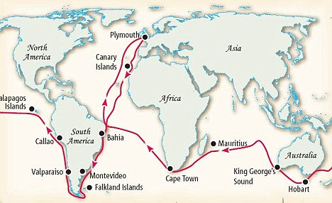

Slide 14
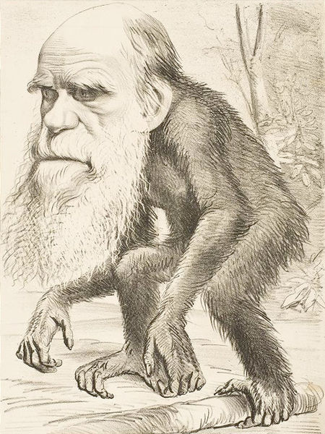
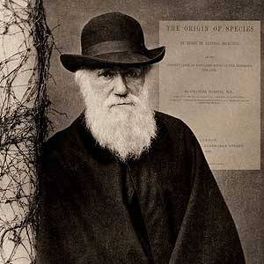
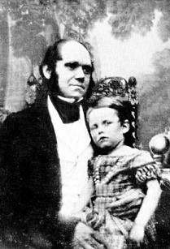
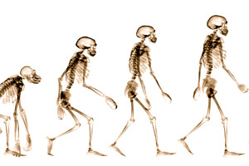

Slide 15
Two Authors Influenced Darwin
Charles Lyell
Rocks are millions of years old (mya).
Earth’s topography is shaped by natural forces.
Uniformitarianism.
Thomas Malthus
Reproductive capacity of man far exceeds the available food supply.
People will have to compete for food & necessities.
Wealthy people have obvious advantages thus are more likely to survive.

Slide 16
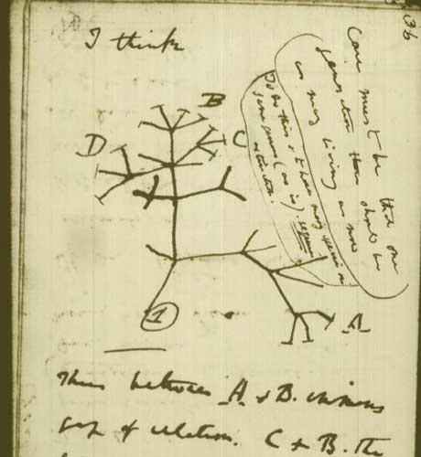

Slide 17
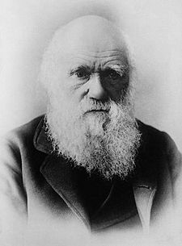
Darwin’s 5 Premises: The Basis of Evolution
Organisms give birth to like organisms.
Chance variations are inherited.
The number of individuals in each generation that survives is small.
Some variations allow individuals to produce more offspring.
Natural selection leads the to accumulation of characteristics.
Lets look at each in detail…..

Slide 18
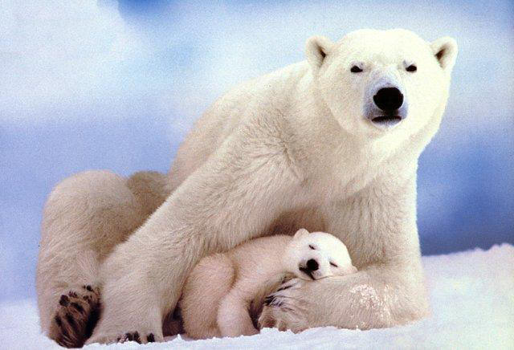
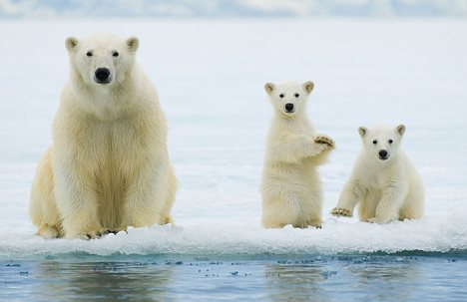
Premise 1: Organisms Give Birth to Like Organisms.
An organism has offspring that are similar to itself!

Slide 19
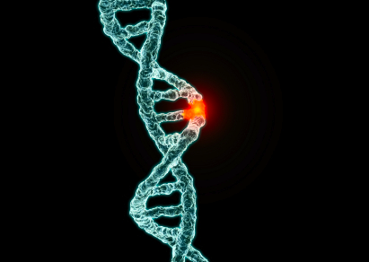
Premise #2: Chance Variations are Inherited
Mutations can change a gene and thus possibly change an individual’s phenotype.
Changes are passed from generation to generation.
Since each DNA sequence is unique, each individual has a unique phenotype.

Slide 20
Premise # 3: The # of Individuals that Survive in Each Generation is Small
There are limited resources in the environment.
Darwin recognized that not all offspring survive to produce more offspring.
Survival depends on genes (genotype) and the resulting phenotype (genotype makes the phenotype)!!

Slide 21
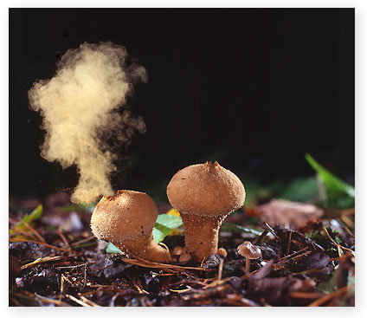
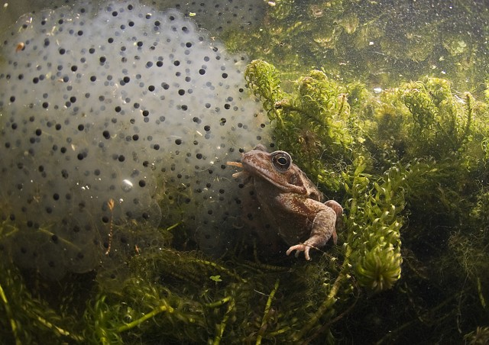
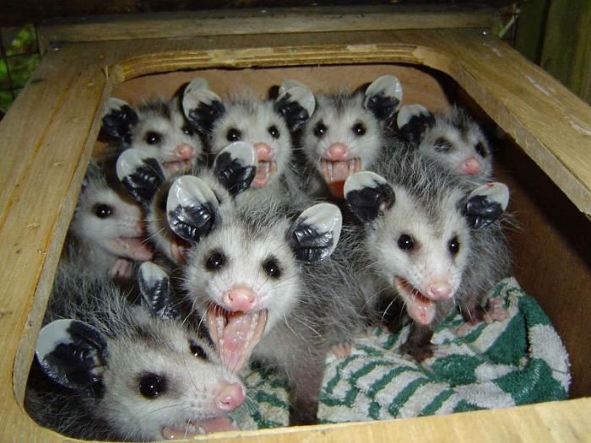
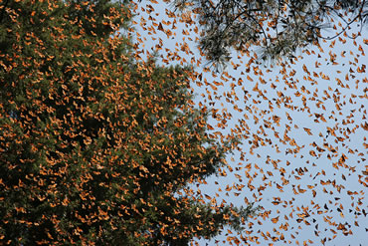

Slide 22
Premise # 4: Some Variations Allow Individuals to Produce More Offspring
Particular organisms within a species have advantages over others.
This is dependent on the phenotype directly interacting with the environment.
As the environment changes the “beneficial” phenotype may also change.

Slide 23
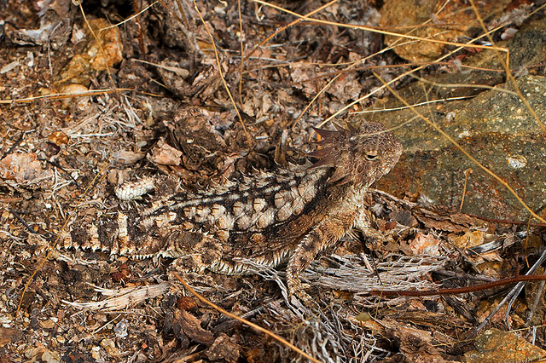
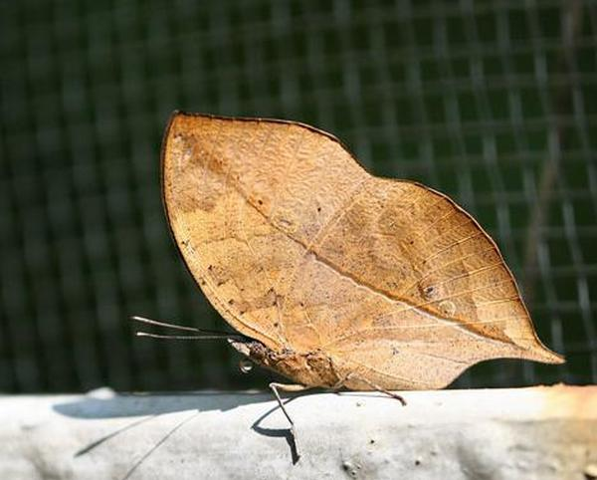
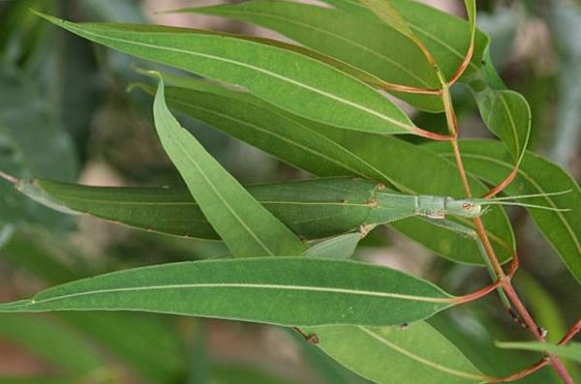
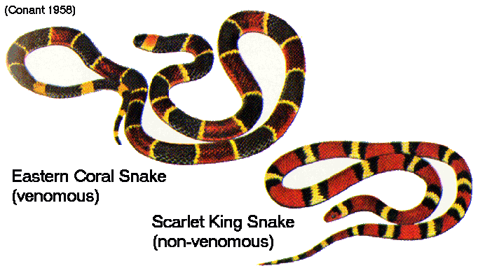

Slide 24
Premise #5: Natural Selection Leads to the Accumulation of Characteristics
Interaction between phenotype and environment.
Those with the better suited phenotype will survive.
If they survive, they are more likely to reproduce.
Those genes will accumulate within a population.

Slide 25
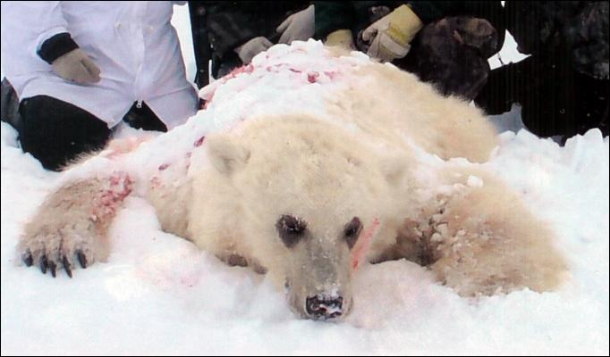
More Natural Selection
Natural selection is always taking place.
It accelerates when resources are scarce.
Environment (all the abiotic AND biotic factors) and its interaction with phenotypes dictate which variations are “successful”!

