Slide 1
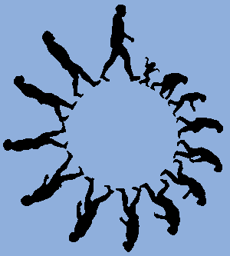
Evidence for Evolution

Slide 2
Prefixes, Suffixes, and Vocabulary
Macro: larger, big.
Micro: small.
Microevolution: change in alleles from generation to generation.
Macroevolution: making a new species.

Slide 3
REVIEW…Listen & Remember!!
Definition of evolution.
Natural selection as a mechanism of natural selection.
Darwin’s 5 premises.
The effects of evolution on the phenotypes and genotypes of a population.
Role of the environment in evolution.
Speciation.. how and why it occurs.

Slide 4
Evidence for Microevolution
Antibiotic Resistance
During WW II antibiotics were widely used to kill bacteria and prevent infections.
Soon bacteria were becoming immune or unaffected by the antibiotic.
Resistant bacteria were not killed.
The resistant bacteria reproduced and survived.
The gene pool changed over time.

Slide 5
Evidence for Macroevolution
Fossil Record
Homologous Structures
Embryonic Structures
Vestigial Structures
Molecular Similarities

Slide 6
Fossil Record
Layers of rock (mostly sedimentary) contain fossils.
Law of Superposition: those fossils found lower are older than ones found higher.
3.5 byo life forms have been found.
Some lineages are complete (horse, vascular plant, whales).
Transitional fossils have been found.
Shows the progression of simple organisms to more complex.

Slide 7
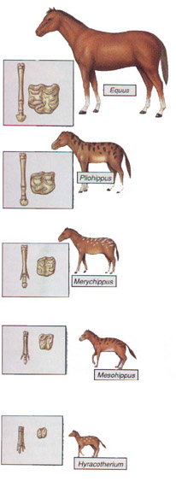
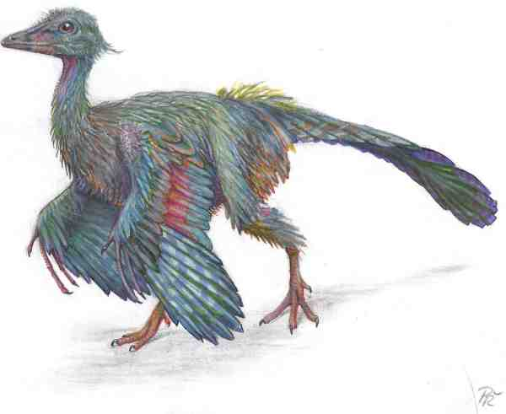
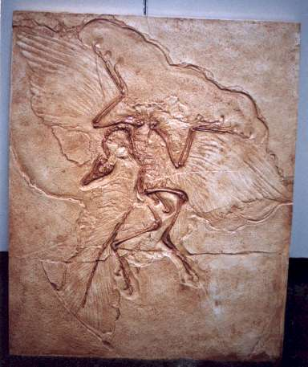

Slide 8
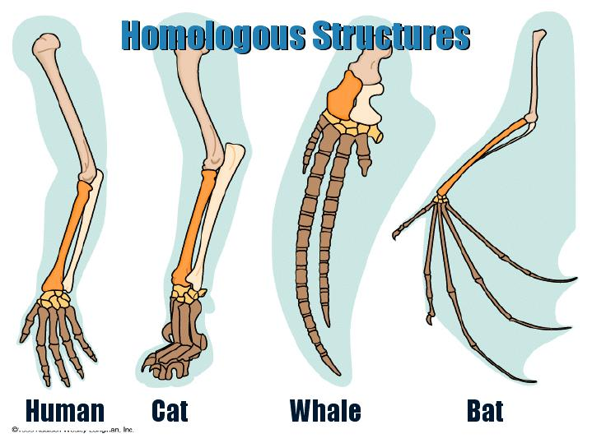
2. Homologous Structures
Structures that are common in related creatures but have different functions.
Same structure on the inside.
Different functions on the outside.

Slide 9
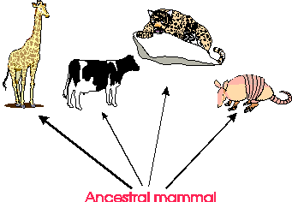
Illustrates divergent evolution.
Divergent Evolution: comes from a common ancestor and branches out into different structures.

Slide 10
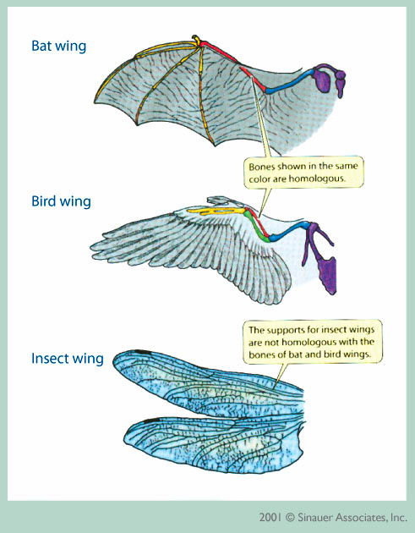
Analogous Structures: Structures that have the same function but have evolved from different ancestors.
Example: Bird wings and butterfly wings.

Slide 11
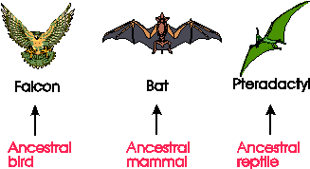
Convergent Evolution
Come from different ancestors and converges based on the function of the structure.

Slide 12
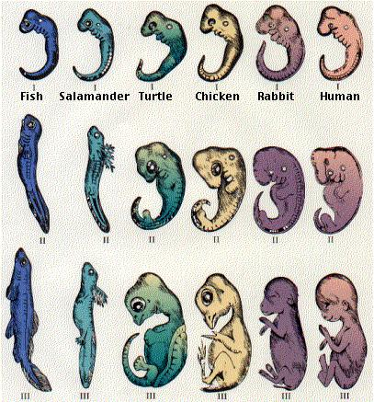
3. Embryonic Structures
Similar structures during embryo development.

Slide 13
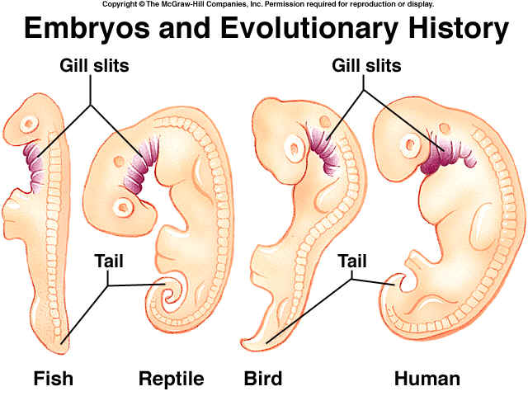
4. Vestigial Structures
Structures that have lost their function as a result of adaptation.
Examples:
Appendix in humans
Pelvic bone in snakes
Wings on non-flight birds
Bone legs in whales

Slide 14
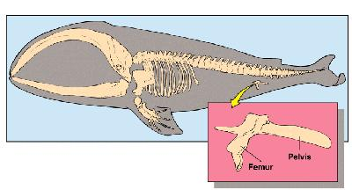
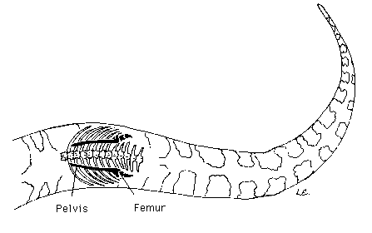
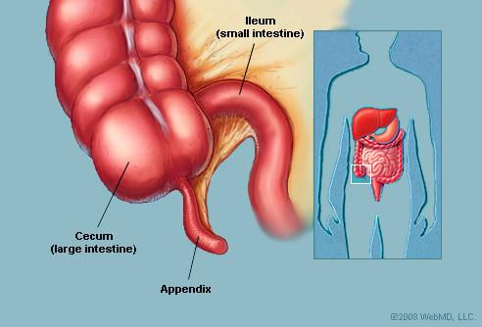
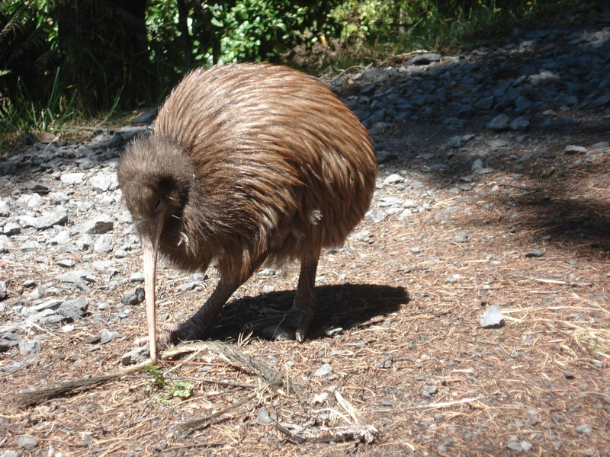

Slide 15
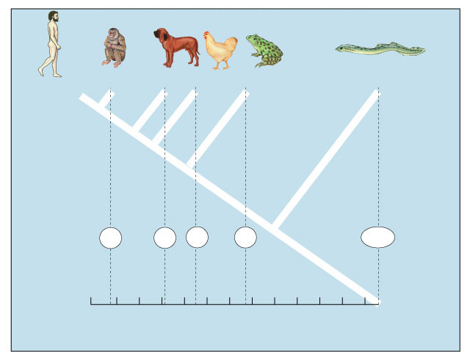
5. Molecular Similarities
Comparing DNA and protein structure.
Everyone uses the same genetic code.
Comparing common genes & proteins reveals how similar structures are.
number of amino acids different from human hemoglobin
Human
Macaque
Dog
Bird
Frog
Lamprey
compare common genes
compare common proteins
8
32
45
67
125
0
10
20
30
40
50
60
70
80
90
100
110
120

