Slide 1
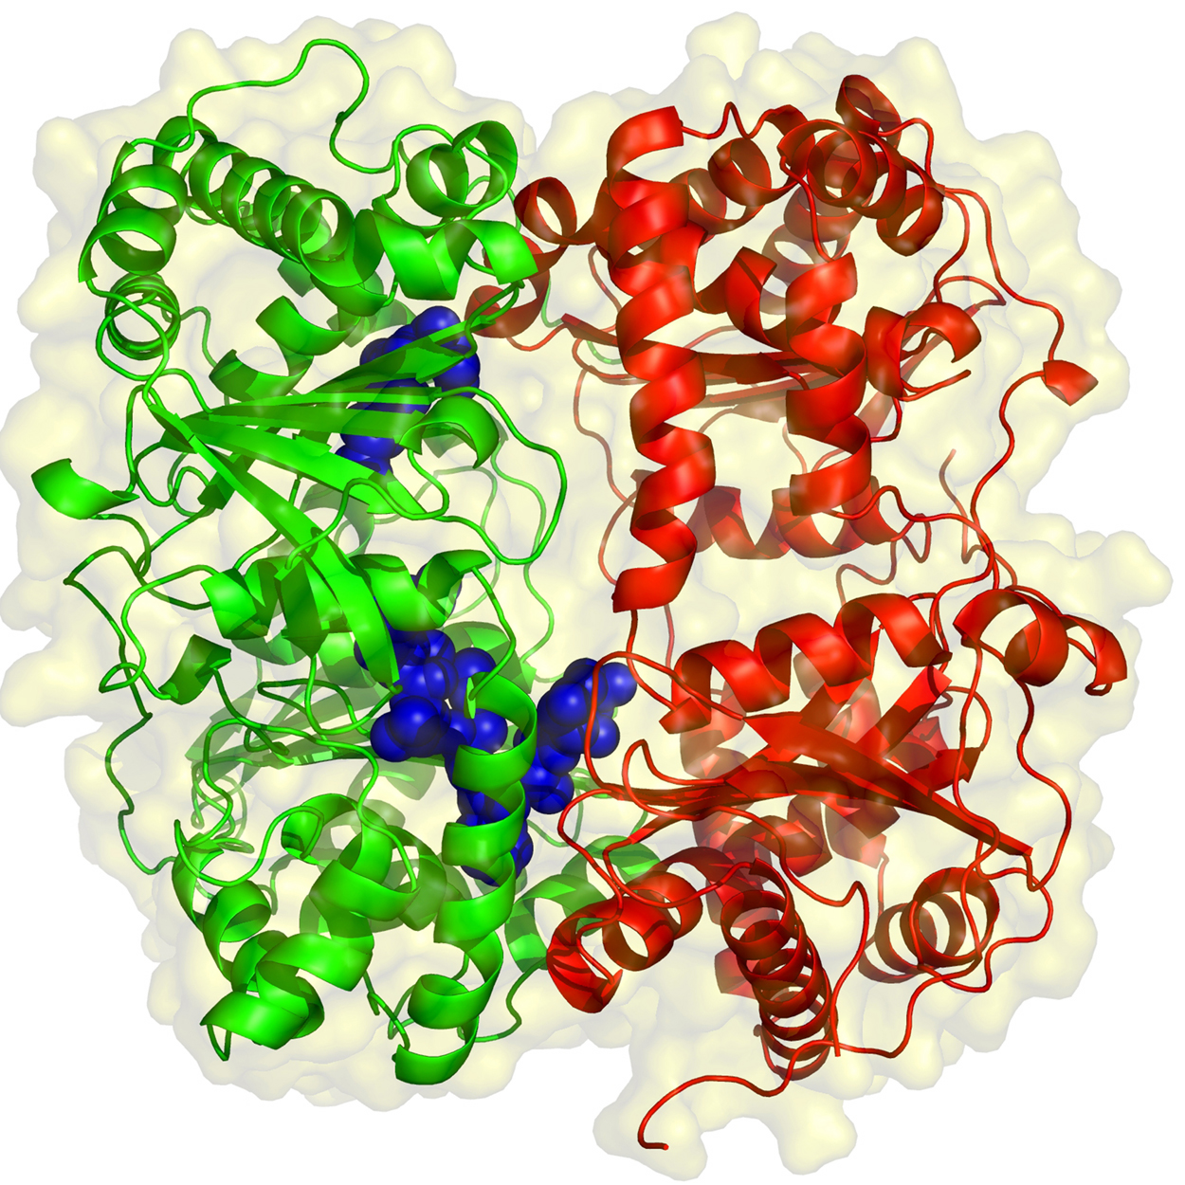
Enzymes

Slide 2
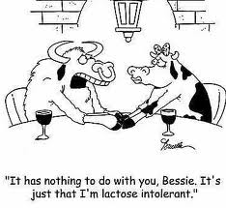
Prefixes, Suffixes, and Vocabulary
Catalyst: speeds up a reaction without being changed.
Denature: to alter the 3D form and render useless.
Substrate: what the enzyme acts on.
-ase: enzyme
-ose: sugar

Slide 3
What is an Enzyme??
Enzymes are proteins.
Enzymes are natural catalysts.
Enzymes are specific for every reaction.
Enzymes catalyze all reactions in all living organisms (over 3,000 different enzymes found in humans!!)

Slide 4
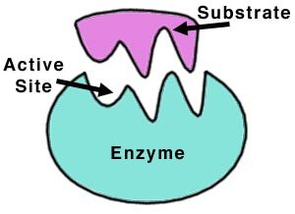
How Does an Enzyme Work?
Enzymes have an active site.
The enzyme binds to the substrate at the active site (where the “action” is taking place).
They connect briefly and a product is formed (hand and glove).
Enzymes are reusable.

Slide 5
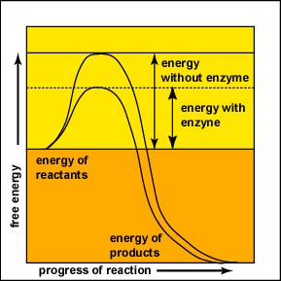
How do enzymes work?
Enzymes lower the activation energy of a chemical reaction.
Activation Energy: the “start up” energy of chemical reactions.

Slide 6
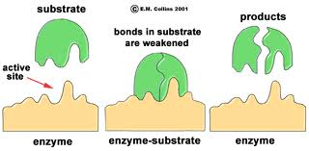
Copy this diagram!

Slide 7
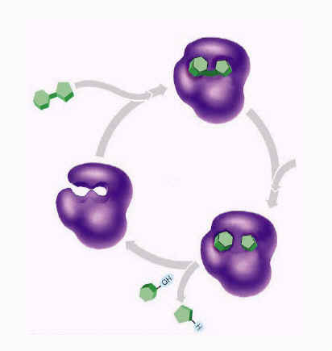
Label:

Slide 8
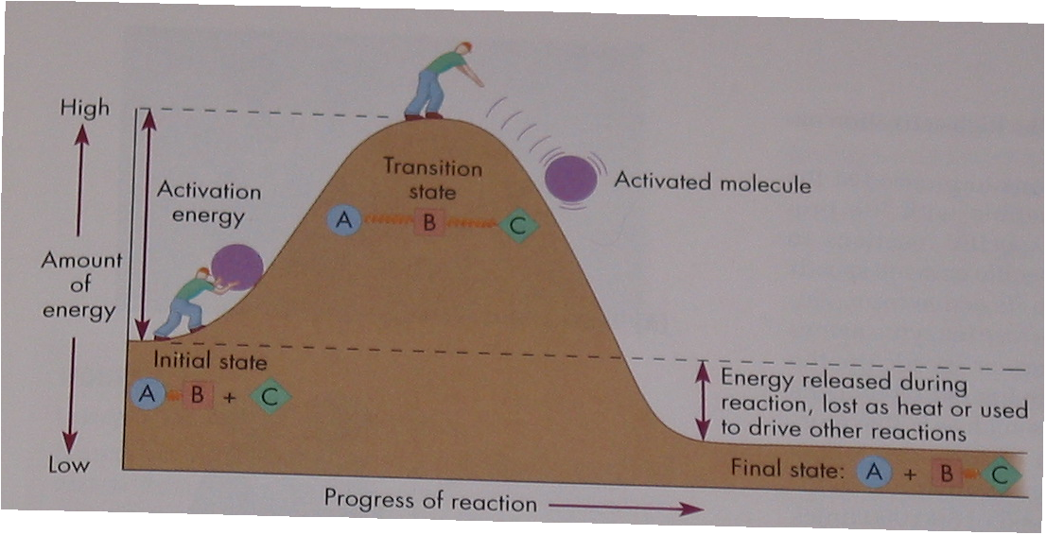
Check out the amount of energy needed to push the boulder up the hill…..
How could that activation energy be lowered?

Slide 9
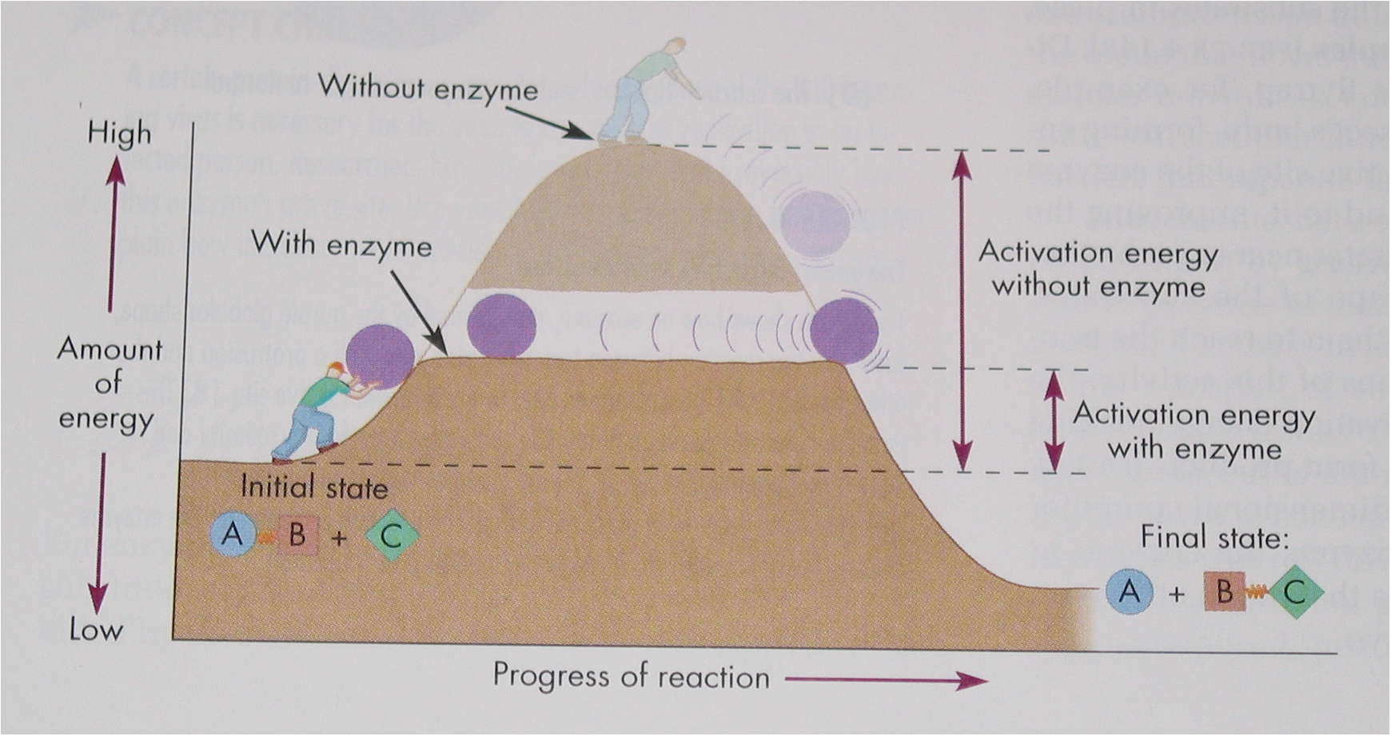

Slide 10
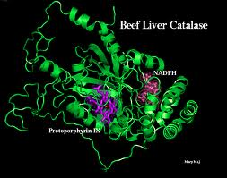
Factors that Effect Enzyme Activity
Why did the enzyme catalase not always work in our lab?

Slide 11
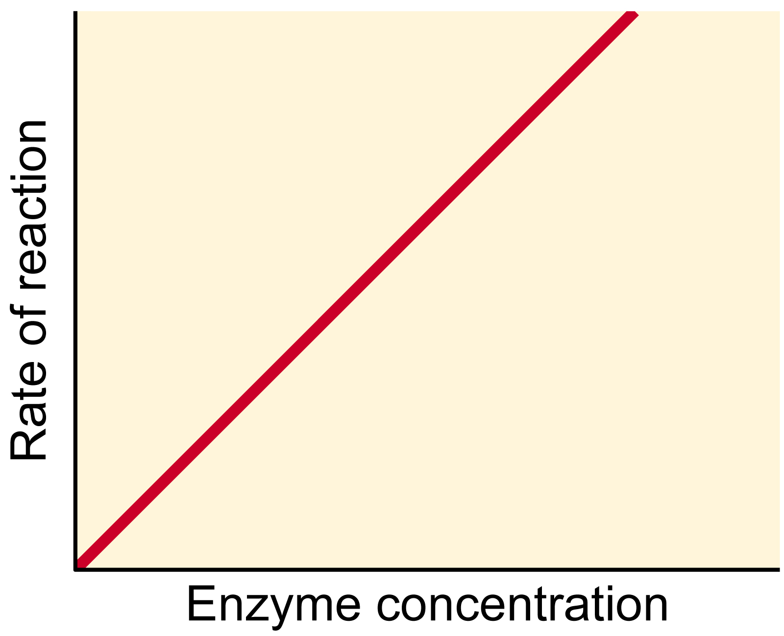
Concentration
More enzyme there is, the more product that is formed.

Slide 12
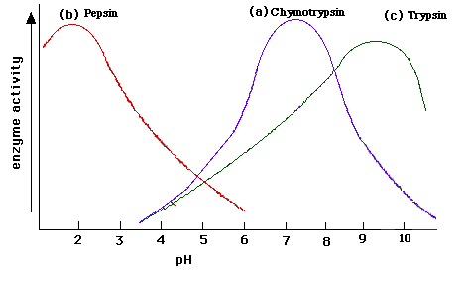
2. pH
All enzymes have their optimal pH.
Enzyme denatures when found outside of this range.
What is the optimal pH for pepsin?
Where in the body might this be found?

Slide 13
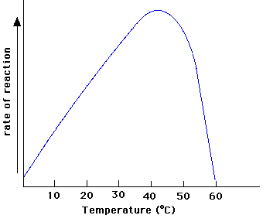
3. Temperature
All enzymes have their optimal temperatures.
Enzymes slow down at low temperatures.
Enzymes denature at high temperatures.

