Slide 1
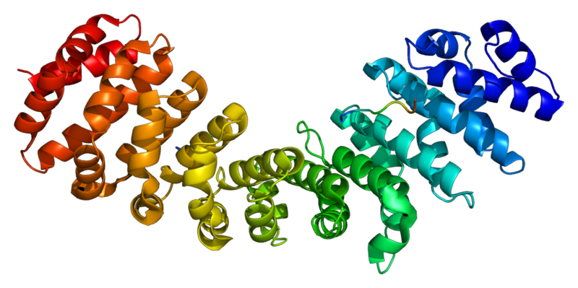
Polypeptides, Amino Acids, and Codons

Slide 2
Prefixes, Suffixes and Vocabulary
Poly = many
Peptide bond =bond between two amino acids.
Anti = against, opposite
Dehydration = loss of water
Polypeptide = long assembled string of amino acids.

Slide 3
What we already know….
DNA is copied to form mRNA in a process called transcription.
Polypeptides are formed in the process termed translation.
mRNA brings the coded information to a ribosome within the cytoplasm (acts as the messenger - hence mRNA).
tRNA (transfer RNA) transports amino acids to the ribosome where they are assembled into polypeptides.

Slide 4
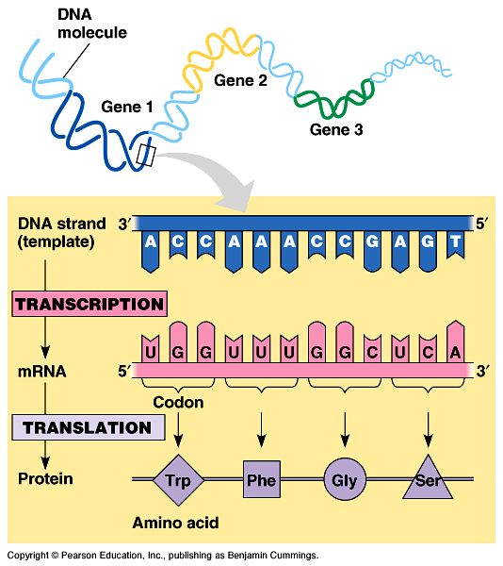

Slide 5
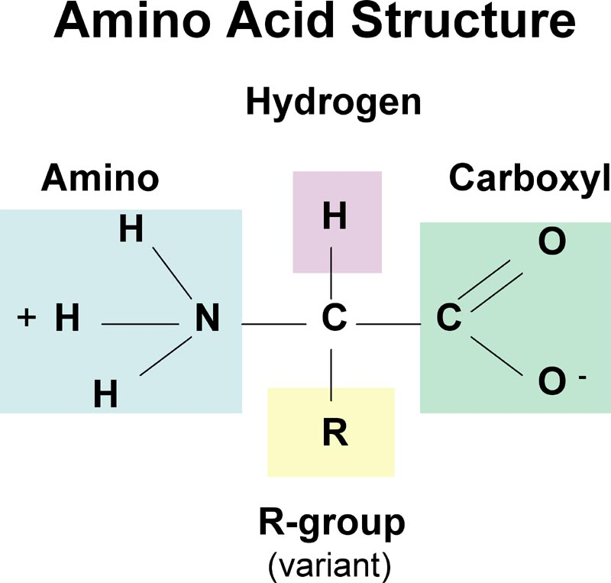
Amino Acids & Polypeptides
Polypeptides are polymers of amino acids.
Amino Acids have 3 parts:
Amino group (-NH2)
Carboxyl group (-COOH)
R group (variable)
Copy this!

Slide 6
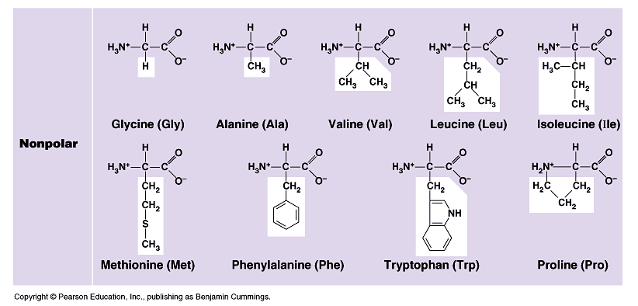
The “R” Group makes each amino acid unique.
There are 20 different amino acids which all have the same skeleton BUT vary with the “R” group.

Slide 7
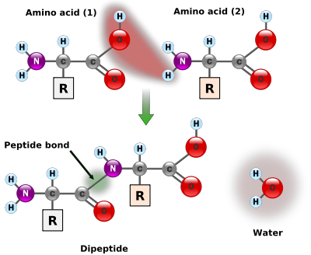
Creating the Polypeptide
A covalent bond joins amino acids.
The reaction is called dehydration synthesis.
The bond between the two amino acids is called a peptide bond.

Slide 8
Transfer RNA (tRNA) bring amino acids(20 different kinds) over to the ribosome.
The mRNA code dictates which amino acid will be brought over.
On one side of the tRNA is the amino acid, on the other is the “anticodon”.
The anticodon is the complement to the codon!

Slide 9
Draw this picture of a tRNA molecule in your notes:

Slide 10
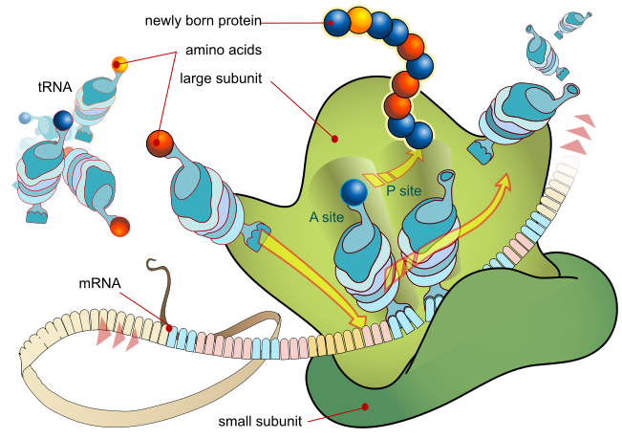

Slide 11
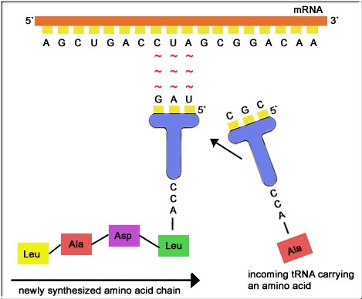
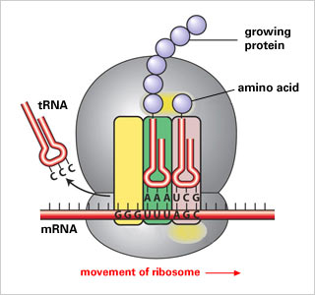

Slide 12
Results:
String of amino acids (polypeptide).
The polypeptide will be pushed out in the cytoplasm where it will be folded into its final 3D configuration.
The final 3D structure will be the finalized protein!

Slide 13
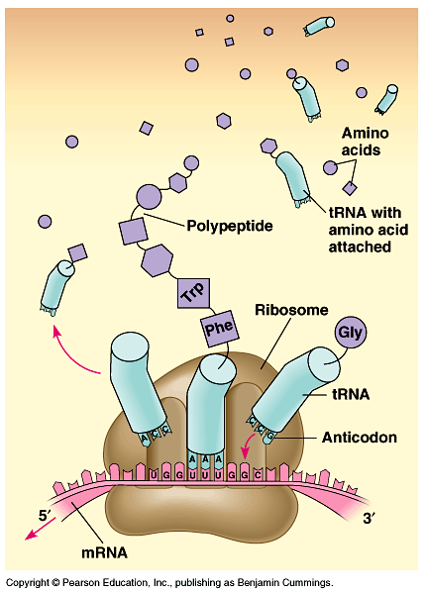

Slide 14
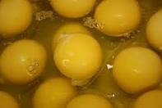
Functions of Proteins
Enzymes: speed up chemical reactions.
Support: Hair, nails, scales, feathers.
Storage: yolk sac.

Slide 15
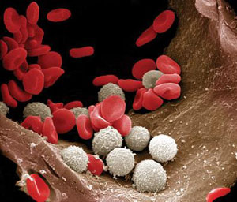
4. Movement: muscles made of actin and myosin.
5. Transport: hemoglobin in RBC.
6. Defense: white blood cells

Slide 16
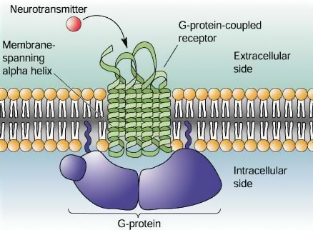
7. Hormones: testosterone, estrogen.
8. Receptors: found on cell membranes, used to communicate within the cell.

