Slide 1
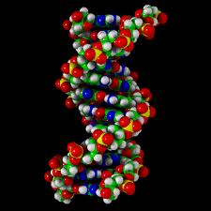
Central Dogma and the Structure of DNA

Slide 2
Prefixes, Suffixes and Vocabulary
Dogma = a pattern of thinking
Gene = section of DNA that codes for a protein
Poly = many
Polymer = many individual subunits connected together

Slide 3
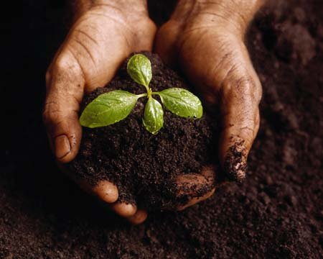
We now know the 7 Characteristics of Life..
Our next question is…WHAT controls these characteristics of life??

Slide 4
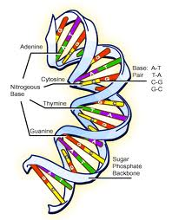
The molecule responsible for life and controlling its processes is DNA.
DNA = Deoxyribose Nucleic Acid is a polymer of nucleotides.

Slide 5
DNA is a very special molecule
DNA…
Contains all of the information (called genes or genetic material) for each living creature.
Is extremely stable.
Contains the information to copy itself.
If a ‘mistake’ is made in the DNA molecule, this ‘mistake’ is continually passed on to future descendants.

Slide 6
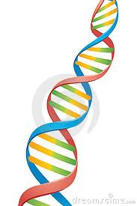
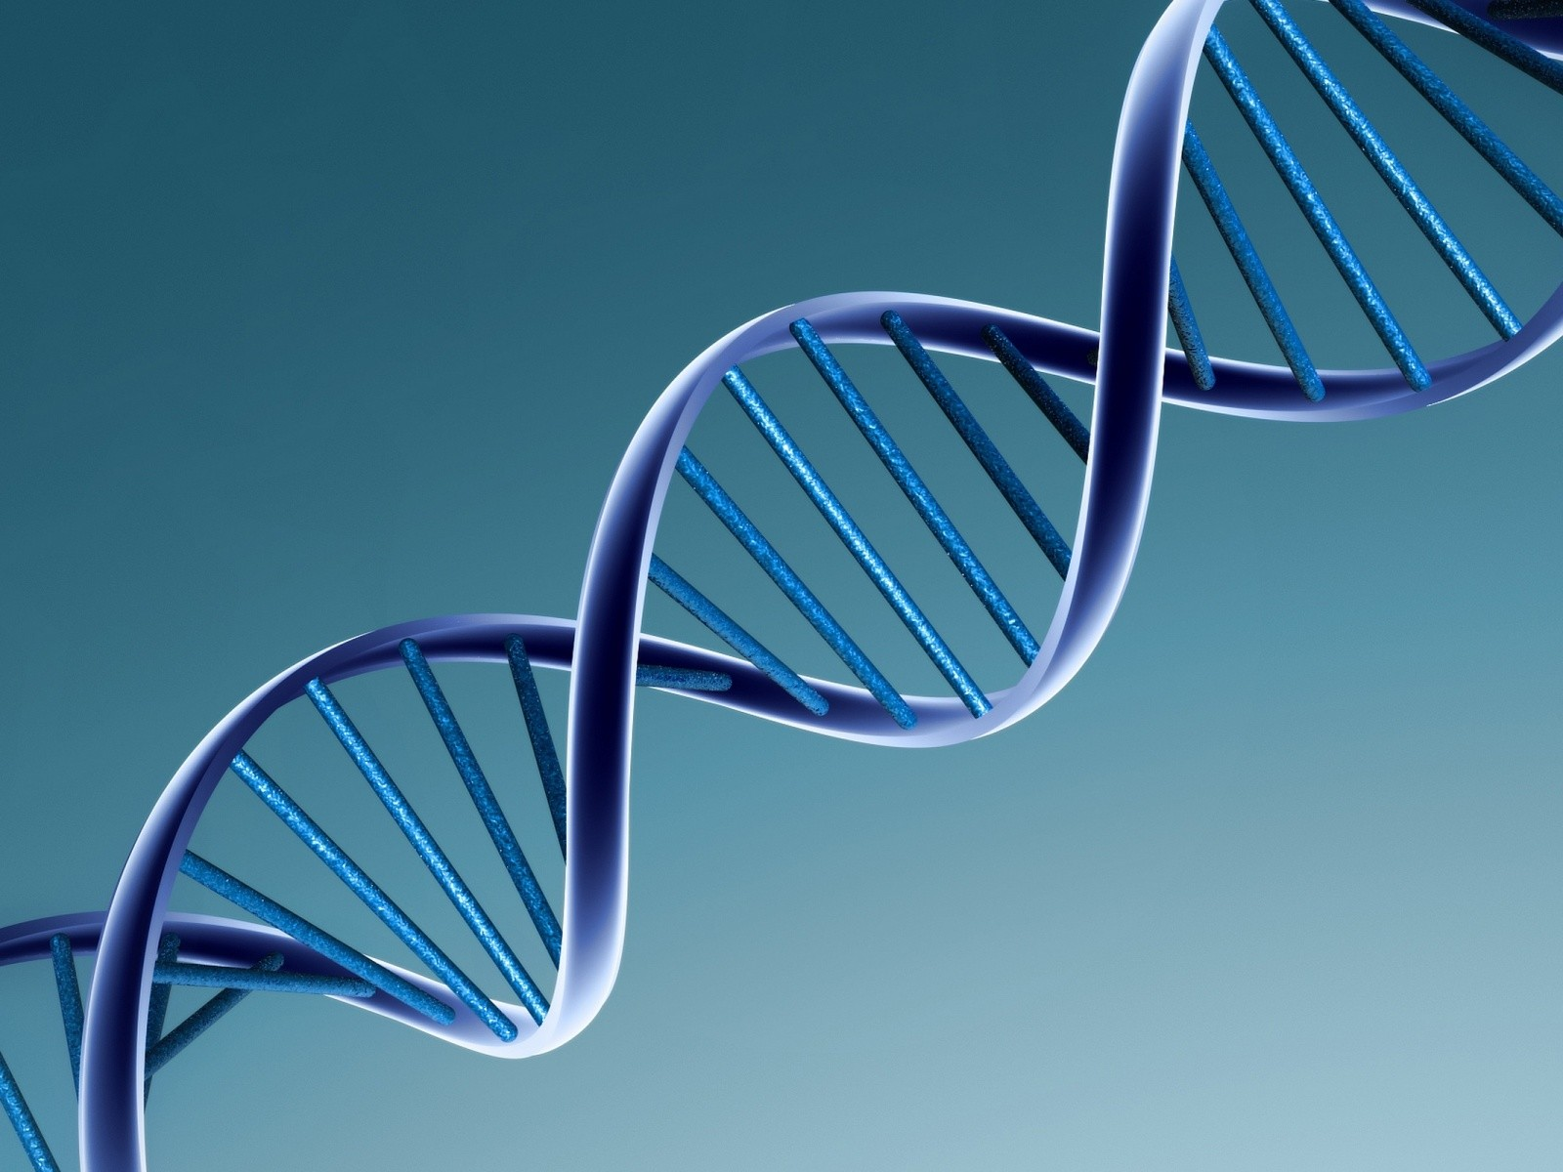
Structure of DNA
Polymer of nucleotides.
Arranged in a double helix.

Slide 7
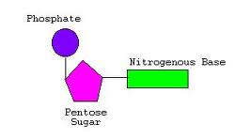
A nucleotide has 3 main parts:
phosphate group
pentose sugar
nitrogenous base
Draw and label the following diagram:

Slide 8
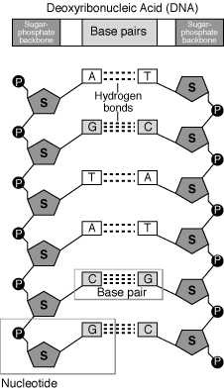
The nucleotides are linked together to form a chain (polymer) in a very specific orientation.

Slide 9
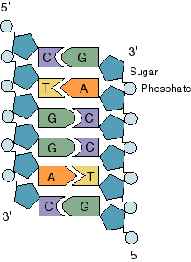
DNA is double stranded.
The strands are arranged opposite to each other.
The base adenine(A) always pairs with thymine(T).
The base guanine (G) always pairs with cytosine (C).
These are called base pairs.

Slide 10
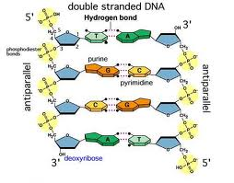
The two strands are kept together by hydrogen bonding.

Slide 11
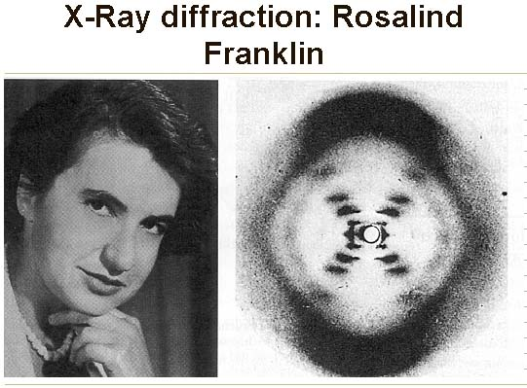
DNA has a Double Helix shape
Because of the shape of the molecules the two stands twist around each other.
This structure was discovered in 1953 by Francis Crick and James Watson.
They stole a X-ray picture from Rosalind Franklin.

Slide 12
Practice DNA Synthesis
What would be the sequence and orientation of the complementary strand?

Slide 13

ANSWER!!

Slide 14
Information in DNA
A bunch of directions linked together in a long chain.
Each set of directions are called gene.
Each gene has to be expressed.
Expressing it is like turning it on.
The Central Dogma: the flow of information that turns a gene on.

Slide 15
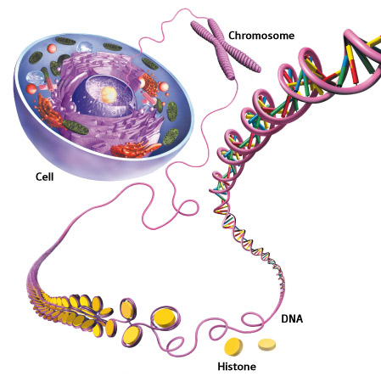
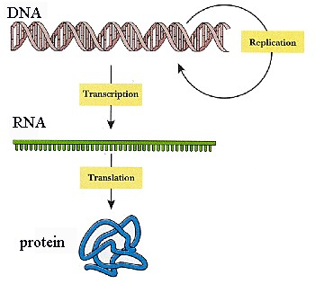

Slide 16
The Central Dogma
DNA
transcription
RNA
translation
Protein

