Slide 1
Cell Growth
and
Cancer

Slide 2
Prefixes, Suffixes, and Vocabulary
Review:
Pro=
Eu=
Hypo=
Hyper=
Iso=
A=
Hetero=
Homeo=
Poly=
Bio
-ology
-ose
Telo-
Ana-
Kinesis-
Meta-
-ase
Mono-

Slide 3
What We Know…….
In order to be a living organism, it must GROW & DEVELOP.
Cells divide by the Cell Cycle.
Cell growth occurs during Interphase.
Nuclear division happens through mitosis.
Cytokinesis is when the actual cell splits.
Now you might be asking yourself.. why can’t cells just continue to grow forever??

Slide 4
Surface Area to Volume Ratio is the Reason Why!!
Volume is the amount of “stuff” inside: (l x w x h).
Surface area is the area of all the sides: (l x w x #of sides).
As cell size increases, the volume increases at a faster rate compared to the surface area.

Slide 5
For example:
A “cell” that is a cube has both sides 1mm.
Surface Area
6mm²
Length x width x # of sides
1mm x 1mm x 6 sides
Volume
1mm³
Length x Width x Height
1 x 1 x 1
The surface are to volume ratio= 6:1

Slide 6
If we doubled the size….
Surface area would be 24mm²
Surface Area
24mm²
Length x width x # of sides
2mm x 2mm x 6 sides
Volume
8mm³
Length x Width x Height
2 x 2 x 2
The surface are to volume ratio= 3:1

Slide 7
Doubling the cell size increases the volume 8x!!!
The plasma membrane (surface area) only increased 4x!
Cells want a HIGH surface area to volume ratio!!
The larger the surface area to volume ratio, the more plasma membrane space is available to absorb nutrients and remove wastes!!

Slide 8
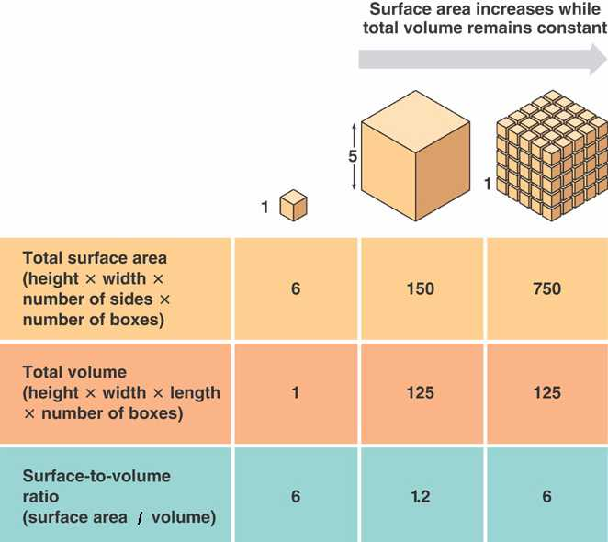

Slide 9
What if Cells Just Continued to Divide?
Cancer Cells
Cells that divide uncontrollably.
A mutation to the DNA occurred that affects normal cell growth and development.
Can form a tumor: abnormal mass of cells.
Can be benign (non-threatening) or malignant (destroys surrounding healthy tissue).
Cells can metastasize: spread to cells beyond their original site.

Slide 10
What Causes Mutations in DNA?
Mutations are Caused By:
Carcinogens: substances that damage cells causing increased cell division.
Tobacco
Asbestos
Alcohol
Radiation
2. Genetic predisposition.
3. Sometimes spontaneous change.

Slide 11
