Slide 1
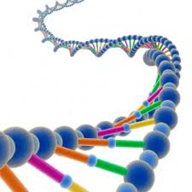
Genetic Diseases and Pedigrees

Slide 2
Prefixes, Suffixes, and Vocabulary
Pedigree: Pictorial representation of genetic traits.
Sibling: brother or sister.

Slide 3
What We Have Learned So Far..
We have learned about Mendel’s 2 Laws
- The Law of Segregation
- The Law of Independent Assortment
How information is passed onto the next generation in the form of genes on chromosomes.
Genes exist on autosomal and sex determining (sex linked) chromosomes.
We know that different forms of a gene are called alleles and alleles can be dominant and recessive.
All of these genes combined, each unique combination makes each individual unique.

Slide 4
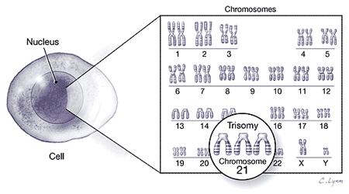
Can Our Genes Be Harmful??
Our immune system(controlled by our genes) fights off attacks from the environment.
While our genes help us fight disease, our genes can cause illness, diseases and even death.
There are a lot of genes that cause disease and illness. Some include Alzheimer’s, diabetes, and many forms of cancer.

Slide 5
Classic Diseases
Autosomal Recessive
Sickle Cell Anemia
Albinism
Autosomal Dominant
Dwarfism
Huntington’s Disease
Sex-Linked Recessive
Hemophilia
Muscular Dystrophy

Slide 6
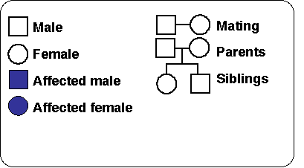
Pedigree
Classic way to look at genetic diseases.
Can calculate odds of particular genetic combinations.

Slide 8
Disease is autosomal recessive. Copy & fill in probable geneotypes.

Slide 9
Blood Typing
Type A: I^{A}I^{A}, I^{A}i
Type B: I^{B}I^{B}, I^{B}i
Type AB: I^{A}I^{B}
Type O: ii

